Slide 1
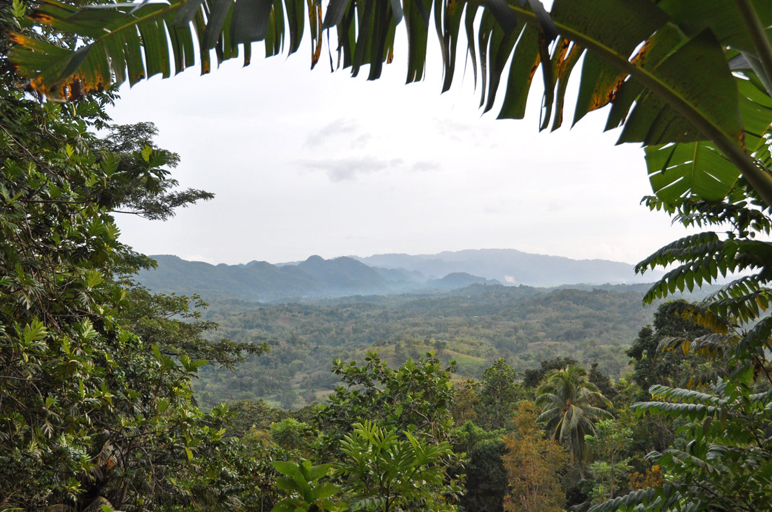

Preserving Maroon Heritage:
The Accompong Museum
Kassie Edwards, Research Assistant
National Museum of African American History & Culture
Smithsonian Institution
Notes:
Good Afternoon Everyone. My name is Kassie Edwards and I am a research assistant at the Smithsonian National Museum of African American History and Culture. I was born in NYC to two immigrant parents who originated in Jamaica. My mother who is here with me in the back is from Wait-A-Bit, Trelawney. Wait A Bit is a small community (or as they call it in Jamaica BACKA BUSH) located at the edge of Cockpit Country in which this presentation’s Accompong Village is situated. Funny story about why its called Wait A Bit, urban legend says that a man passing through town asked a farmer what town is this. The farmer, in a hurry, said wait a bit and left to tend to something else. The passerby left assuming the name of the town is Wait-A-Bit, while that might be an anecdotal explanation, more than likely it is named after a thorny bush brought from Africa which is used as hedges to protect against wild animals. So it really is BACKABUSH lol
A little bit about me, I graduated from Florida State in 2010 with a BA in African American Studies and a minor in Museum Studies. During my studies I was particularly interested in prehistorical African history and implicit bias. 2 years ago I received my MPA from Washington Adventist University where I focused on social justice policies and entities. I love my job at the Blacksonian as its called. I work with Curators like our very own JoAnne Hyppolite and Jackie Serwer to research provenance and histories about objects and the people who created them. Some of my other research projects include Prince Demah, the first documented enslaved portrait artist and Romare Bearden’s murals in NYC Schools.
I got inspired to conduct this research after taking a pilgrimage trip back to my ancestral home of Jamaica last summer for my 30th birthday. My family and I took a trip to the Accompong Village in Cockpit Country. The museum inspired me to spread the word about the marvelous triumphs of these people’s descendants who have overcome kidnapping, enslavement, murder and torture. My hopes is that this presentation will inspire other community leaders and influencers to capture similar histories in their home countries.

Slide 2
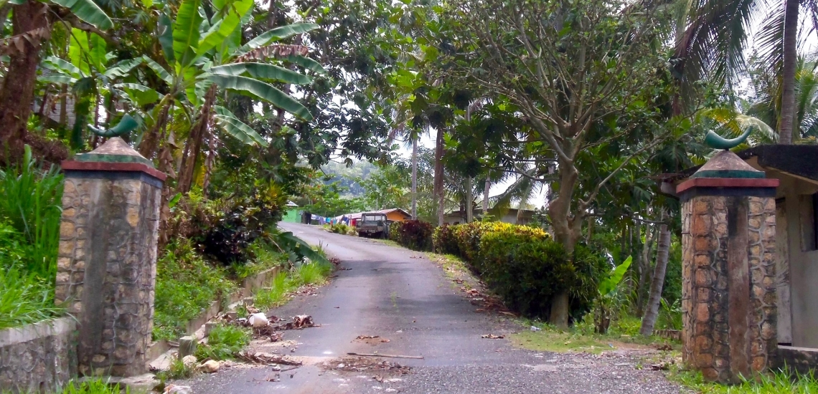
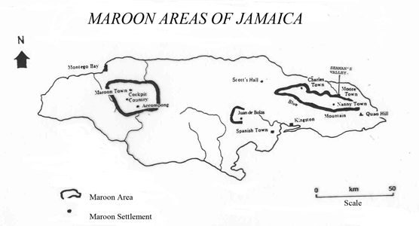
Accompong Maroon
St. Elizabeth Parish, Jamaica
The Accompong Maroons are the historic descendants of runaway slaves, who waged successful wars against the British and gained quasi self-governance through a treaty negotiated by their leader Cudjoe in 1738. Every year on January 6, the community hosts peace treaty celebrations.
Notes:
Maroon villages are not a new phenomenon amongst indigenous or displaced ethnic groups. In most colonized Caribbean islands you can find a group of indigenous peoples or self emancipated communities that have been successful in its rebellion against the imposing colonialist forces. Most groups escape to mountains as they offer cover from colonial forces who are ignorant of the terrain. The word Maroon derives from the Spanish word Cimarron wild or Cima Summit. Literally translated as dwelling on peaks and usually is a reference to enslaved African runaways. I do not like using the term runaway, I think its more appropriate to say self-liberated or self emancipated.
Today I will be highlighting the Accompong Settlement which situated in the St Elizabeth Parish “Backabush” of Cockpit Country. The town of Accompong was named after the Maroon leader Accompong, who was from an Ashanti family and was the brother of a number of other Maroon leaders – Quao, Cuffy, Cudjoe, and Nanny.
First I want to give a very brief overview of Jamaica, Land I Love!
https://drive.google.com/a/wau.edu/open?id=1hCEq2aTlugJhAuCca3ak8esQ8FQ&usp=sharing

Slide 3
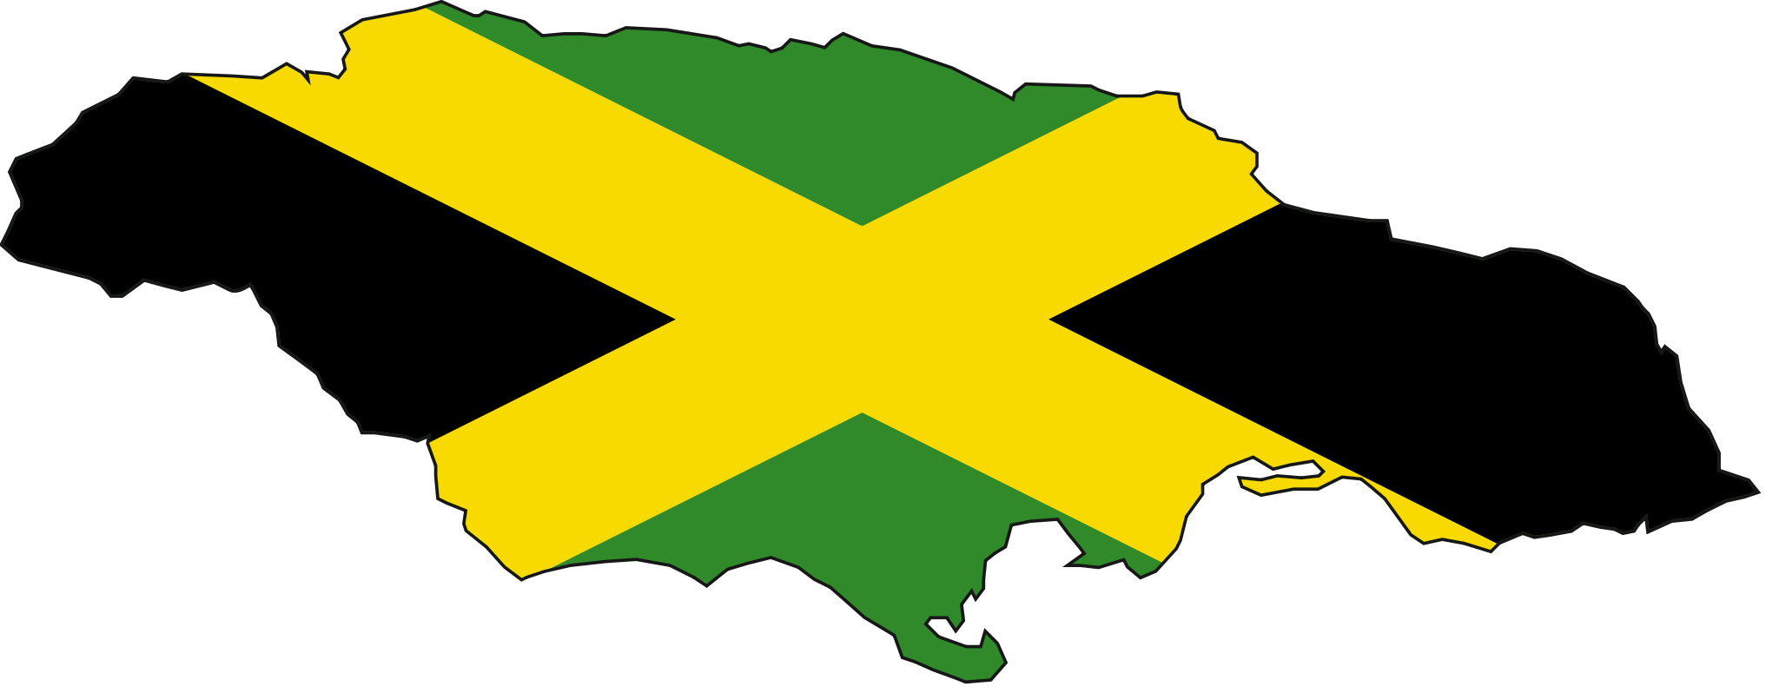
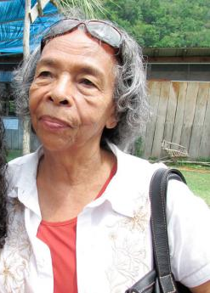
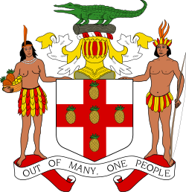
History of Jamaica
Originally inhabited by Arawak also called Taino peoples
Jamaica derives from the Taino word Xaymaca
Christopher Columbus “discovered” Jamaica in 1494
Spaniards claimed the island and named it Santiago
English attacked in 1655 and used Jamaica as a crop cash cow
1808 England outlawed the slave trade
Granted independence in 1962
Notes:
The indigenous people, the Taíno, called the island Xaymaca in Arawakan, meaning the "Land of Wood and Water" or the "Land of Springs“
Little is known about the island’s early history, except that there are many traces of Arawak habitation, and that Arawaks, agriculturists who made good-quality textiles and pottery, were living there when Christopher Columbus landed on 14 May 1494, on his second American voyage of exploration. He named the island Santiago (Saint-James).
The Spanish arrival was a disaster to the indigenous peoples, great numbers of whom were sent to Spain as slaves, others used as slaves on site, and many killed by diseases and at the hands of invaders, despite the efforts of Spanish Christian missionaries to prevent these outrages. It is said that there were no Arawaks left on the island by 1665, and enslaved Africans had replaced them. There are little anecdotal stories in which some have claimed to trace their taino roots. Such as this picture of Olive Moxam-Dennis
http://www.nationsonline.org/oneworld/History/Jamaica-history.htm

Slide 4
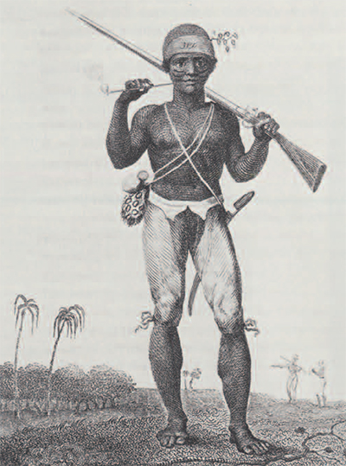
History of Jamaican Maroons
1655 – English invades; Spanish colonist fled; enslaved Africans & Tainos set free or escaped to the mountains
1673 – 1690 Imported slaves and major slave uprisings
1728 – The First Maroon War
1738 – Treaty signed by Cudjoe
Surinam Ranger
Notes:
1655 – The Invasion of Jamaica was a land and sea expedition conducted by the English in the Caribbean in 1655 that resulted in the capture of the island from Spain. Jamaica's capture is considered an act of war that resulted in war between England and Spain in 1655.
1500 formerly enslaved Africans were set free by the fledging Spaniards or escaped to the mountains. For a time they wandered while a few leftover Spaniards put up some last ditch warfare tactics. The Africans or Maroons formed themselves into three groups associated themselves with Spanish guerillas in symbiotic relationship. For five years they fighting continued between the Maroons-Spanish and British.
One of the groups under Lubola formed an alliance with the British which destroyed the Spanish guerillas livelihood. In 1660 the last of the Spaniards left Jamaica. This alliance also included Lubola’s agreement to hunt down other groups of maroons. The other Maroon groups disagreed with this arrangement and in 1663 Lubola was killed. Still other groups of maroons, like those under Juan de Serras continued to be nuances for the British. In 1670 the British outlawed Serras group and price put on their heads.
The maroons retreated to uninhabited parts of Jamaica. At the same time newly arriving British settlers had begun to import slaves. In 1662 there were about 550 enslaved Africans, in 1668 that number rose to 8,000. By 1703 that number rose to 45,000.
1673 the first slave uprising happened in St Ann when 200 enslaved Coromantee (or gold coast Africans) killed their master and 13 white people. in 1690 a revolt of 400 slaves at Sutton's plantation, Clarendon considerably strengthened the Leeward Maroons
In September 1728, the British sent more troops to Jamaica
By the mid-1730s, warfare was proving costly to Maroons and British alike and was turning into an ongoing stalemate. Cudjoe rejected suggestions of a treaty in 1734 and 1736, but by 1738 he agreed to a treaty signed under governor Edward Trelawny The treaty signed under British governor Edward Trelawny granted Cudjoe’s Maroons 1500 acres of land between their strongholds of Trelawny Town and Accompong in the Cockpits and a certain amount of political autonomy and economic freedoms, in return for which the Maroons were to provide military support in case of invasion or rebellion, and to return runaway slaves in exchange for a bounty of two dollars each. This last clause in the treaty caused tension between the maroons and the enslaved black population
http://www.nlj.gov.jm/history-notes/The%20Maroons%20edited%20final.htm
Note the decorative scarification on this ranger of Surinam. He was born in Africa, enslaved, and shipped to the New World. There he became a free soldier and hunted Maroons for the Whites. Such rangers were used against Maroons in Jamaica also. They were considered very effective when they could be relied upon, but were often suspect of favoring the “enemy.”

Slide 5
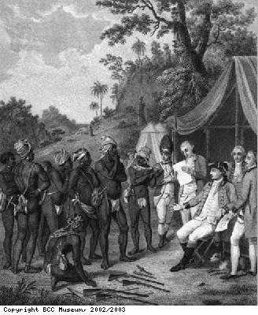
History of Jamaican Maroons (Con’d)
1760 – Tacky’s War
1795 – Second Maroon War
Current Times
  11 Maroon Settlements
  4 Government Recognized Maroon Towns
Pacification with the Maroon Negros (1801)
by Agostino Brunyas
Engraving on paper
BCC Museum
Notes:
1760 – Slave uprising led by a Fante leader named Tacky. Jamaican government called upon the maroons to honor the treaty. Cudjoe and the leeward/windward maroons assisted and were able to quell the resistance.
1795-1796 – Second Maroon War: Parallel to this was the Haitian Revolution. Trelawny Town Maroons rejected the white superintendent assigned to them. A new strict Governor, Balcarres, used military force to demand submission. Instead the Trelawny Maroons faught. After setting up watch points all around Cockpit Country, Governer Balcarres grew impatient and sent for hound dogs from Cuba. Fearing the murderous reputation of the hound dogs, Trewlany town surrendered. The Trelawny maroons were deported to Novia Scotia and then formed a colony in Freetown, Sierra Leone. Some of these Maroons returned later to work as free laborers.
There are approximately 11 Maroon settlements in Jamaica. Only a few are government recognized.

Slide 6
Windward
Maroons
Leeward
Maroons
Notes:
Leeward
Between 1673 and 1690 there were several major slave uprisings, mainly prompted by newly arrived, highly militarized Coromantee groups from the Asante Empire.[8] On 31 July 1690, a rebellion involving 500 slaves from the Sutton estate in Clarendon Parish led to the formation of Jamaica’s most stable and best organized Maroon group. Although some were killed, recaptured or surrendered, more than 200, including women and children, remained free after the rebellion was considered over.[8]
They established an Ashanti-style polity based in the eastern Cockpit Country, notably Trelawny Town; their most famous ruler was Cudjoe.
Windward
The Windward Maroons, in the wilder parts of eastern Jamaica, were always composed of separate highly mobile and culturally heterogeneous groups. From early on, the Jamaican governors considered their settlements to impede British development of the interior. They ordered raids on the Maroon settlements in 1686 and 1702, to little effect.
By about 1720, a stronger Windward community had developed around the culturally Africanised group of three villages known as Nanny Town, under the spiritual leadership of Queen Nanny, an Ashanti woman, sometimes in allegiance and sometimes in competition with other Windward groups. She was known for her exceptional leadership skills, especially in guerrilla warfare during the First Maroon War. One tactic particular to the Jamaican Maroons involved the art of camouflage using plants. Her remains are reputedly buried at "Bump Grave" in Moore Town, the main town of the Windward Maroons, who are concentrated in and around the Rio Grande valley in the northeastern parish of Portland.

Slide 7
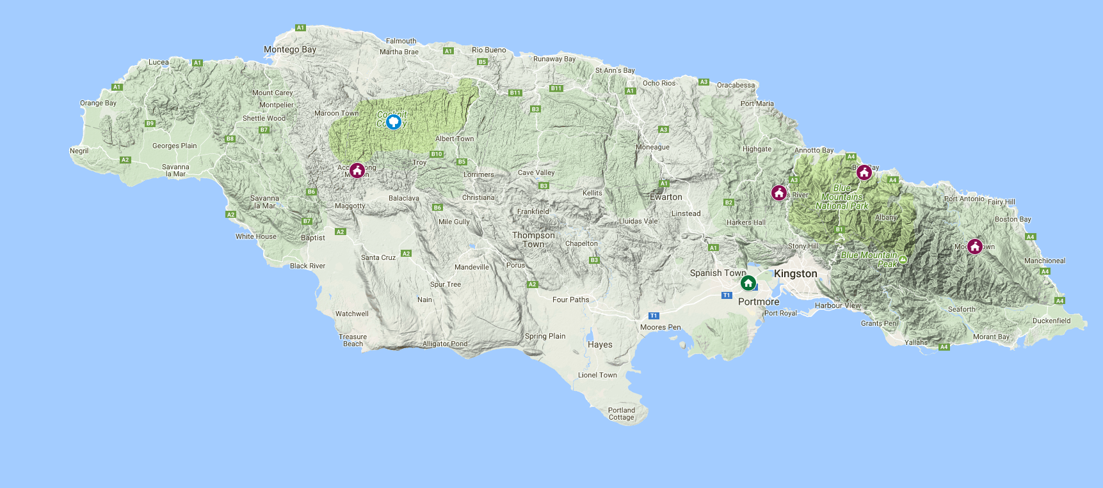
Government Recognized Maroon Towns
Scott’s Hall, St. Mary Parish
Charles Town, Portland Parish
Moore Towne, Portland Parish
Accompong, St. Elizabeth’s Parish
1793, Cudjoe
1754, Quao
1793, Nanny
1739, Cudjoe
Notes:
The Maroon towns are governed by elected chiefs who bear the title of ‘Colonel’. The position of “Colonel” was once a lifetime position but now has been modified to a 5 year elected position. Each Colonel is assisted by a council consisting of men and women who are appointed by him.
In total, the Jamaican Maroons make up for about 15.000 people. Some 5,000 Maroons live around Jamaica and another 10,000 or more are scattered in other countries, mostly Canada, the US and Great Britain.
https://abengcentral.wordpress.com/jamaica/
Scott's Hall Maroons
Scott’s Hall is the principal home to the St Mary Maroons. It was established after the first Maroon War ended, around the same time as Moore Town in 1793. The Scott’s Hall Maroons celebrate the signing of their peace treaty with the British on August 1, which is Emancipation Day.
Charles Town is located inland near the town of Buff Bay in the parish of Portland. The settlement emerged around 1754. Charles Town as a Maroon Community was not named on maps until 1832. Prior to this date, it was identified as New Crawford Town. June 23 – The Charles Town Maroons celebrate this day as their special day with activities taking place at their Asafu Yard in Portland.
Hilly and rugged Moore Town sits in the heart of Portland’s Maroon country. Like Accompong, it was formed in 1793 when Cudjoe signed a peace treaty with the British.
At first, Nanny refused to sign a treaty with the British but eventually agreed to a truce. At first, the Maroons were 500 acres of land after the signing of the treaty. Nanny realized that this allotment was not enough for their needs and made a request to the British government in 1781. They were granted a further 1,270 acres, which was called Moretown. Due to misunderstanding and errors, the name was recorded in the survey document as ‘Muretown’ and later ‘Moore Town.’ Maroons also live in neighbouring Cornwall Barracks.
Nanny’s Maroons divided themselves into two groups, one of which went with her brother Quao to Crawford Town and the other followed her to a new settlement, New Nanny Town, now called Moore Town.
October 18 – The Moore Town Maroons celebrate Jamaica’s National Heroes Day as Nanny Day, to honor the Maroon leader.
Accompong celebrates their treaty signing on January 6 every year. Maroon Town was the original site of the Accompong maroons but they fled to their current town in Cockpit Country after the First Maroon War in 1739.
Hon. Colonel Ferron Williams, Colonel-in-Chief is the elected leader of Accompong 2009-present

Slide 8


Government Oversight
Jamaica National Heritage Trust
Jamaica Social Investment Fund
Tourism Product Development Co.
Founded April 5th 1996
The Tourism Product Development Company (TPDCo) is the central agency mandated by the Government of Jamaica to facilitate the maintenance, development and enhancement of the tourism product.
Passing of Law No. 72 in 1958
The Jamaica National Heritage Trust is responsible for the promotion, preservation, and development of Jamaica's material cultural heritage. The organization maintains the list of National Heritage Sites in Jamaica.
Established in 1996
The Fund was designed primarily to channel resources to small-scaled community based projects. It addresses the immediate demands of communities in a manner that is quick, efficient, effective, transparent and non-partisan.
Notes:
Currently each maroon settlement is self governed and autonomous. The people in these settlements do not taxes on their lands. There is still some debate about the full extent of their autonomy and self-determination. For instance, cannabis is illegal in Jamaica, including Maroon settlements. Some Maroons claim that their treaties protect their rights to cultivate marijuana. However, the Jamaican government has carried out sanctions and raids on Maroon territory “ganja farms”.
Some researchers have noted that the sovereignty these territories hold is mythical or ceremonious more than binding.
During the 2014 Annual International Maroon Conference the minister of Justice, Mark Golding affirmed the maroon settlements soverity citing “The Maroon Treaties provide the legal foundation for their special status under the law. Since independence, the Government of Jamaica has recognized and affirmed the rights of the Maroons, which are underpinned by the UN Declaration on the Rights of Indigenous Peoples. Articles three, four and five of that Declaration speak to the right to self-determination which allows for the free pursuit of economic, social and cultural development. Article four provides for the right for self-government in matters relating to local affairs, as well as ways and means for financing autonomous functions.”
Presently there is no one ministry or government department that specifically deals with Maroon Settlements. I searched through Jamaica’s laws for any mention of Maroon Settlements with no success.
There are three entities that interact with maroon sites providing services.
http://www.tpdco.org/history/
-TPDCo is one of the only Tourism Development agencies in the Caribbean. Other Caribbean/African Diasporic entities like Trinidad & Tobago and Nigeria and Belize Tourism boards have visited TPDCo to learn from their model
http://www.jnht.com/about_jnht.php
-Provides funding and support for historic sites
http://www.jsif.org/content/about-jsif-0
The Jamaica Social Investment Fund (JSIF) is a limited liability company incorporated under The Company’s Act of Jamaica. It was established in 1996 as a component of the Government of Jamaica’s (GoJ's) national poverty alleviation strategy. The Fund was designed primarily to channel resources to small-scaled community based projects. This is done with the use of an Operations Manual that acts as a guide to ensure transparency, accountability and efficiency in project implementation.

Slide 9
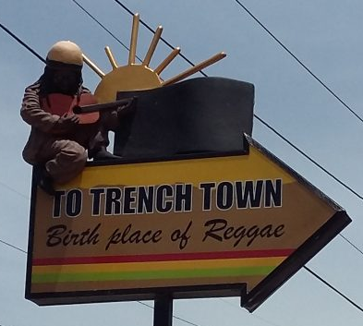
Tourism Development Co.
Development Services
Accompong Village Relationship
Training
Signage
Visitor Safety & Security
Licensure
Environmental Care
Disaster management plan
Provided toilets for the school
Fixed roads
Trained tour guides
Assist with annual festival
Museum operations
Notes:
Hospitality Training of tour guides and best business practices
Signage installed and paid for by tpdco
Security provided during annual festival
Facilitated Peace Corps volunteer to complete rain runoff environmental project
All tourism entities are required to be in possession of a Tourist Board licence as per Section 23A the Jamaica Tourist Board Act (1955) :
Accompong Village is not licensed but TPDCo continues to work with accompong to gain licensure.
Disaster management plan
Culture Yard Trench Town was officially licensed on International Reggae Day 2016. It is a milestone achievement and represents a musical heritage/community tourism project which has been in the re-development process for several years.
Works spearheaded by the TPDco Projects Unit included improvement to the sewage system, upgrading of the kitchen, painting and general improvement works. It is intended to preserve and promote the rich musical heritage of this bedrock of reggae music, the economic development of the community and diversification of the tourism product.

Slide 10
Accompong Village Tourism
Maroon Festival
Tour Guide
Village Museum
Restaurants
Canteens
Peace Cave
Kindah Tree
Burial Grounds
Annually in January
$20USD per person/2 hours
Over 200 objects
2 places serve Jamaican food
Over 5 bars/snack shops
Where peace treaty was signed
Where Cudjoe made war plans
Ancestors laid to rest
Notes:
The Accompong Maroon Festival is a cultural event that celebrates over 200 years since the signing of the peace treaty between Maroons and the British. This year’s festival seeks to shine the spotlight on the life of the heroic Maroons through singing, dancing, storytelling, cooking and more. This festival marks the victory of the First Maroon War against the British in which they fought for their freedom, led by their late hero Cudjoe.
Within the town, individual plots of land are passed down from generation to generation, with no official titles changing hands. Neither the land nor income generating activities within its boundaries are subject to government tax.
Community matters are directed by the Colonel and the council which he appoints. The Colonel is elected every three to five years. In elections held in August 2009, Colonel Peddie was replaced by Colonel F. Williams.
The Accompong Community Center and Museum gives an overview of the history of the town. Includes objects such as goombay drums, a musket, a sword, baskets and other artifacts from the Maroon era alongside Ashanti art and Taino tools. Other parts of the tour include a burial ground, a small herbal garden, which our tour guide gave us some bush to heal our mosquito bites.

Slide 11
Challenges
Licensing is complex process
Funding
Sustainability
Collecting Data & Statistics
Infrastructure
Advertising
TPDCo assistance
Tour Fee, Festival Fee, Private/Public partnership
Assigned tourism admin
Keeping records of tours/visits
JA improves infrastructure
More online presence, accept credit cards
Notes:
Licensing assistance is provided by TPDCo
Funding
Consistent tour fees, collecting donations from visitors, Government infrastructure improvements allow more visitors, grants from Jamaican Historic National Trust
Sustainability
Inconsistent Accompong representatives responsible for tourism development
Data
Currently there is a visitor sign in sheet in the museum space, this information could be digitized to collect visitor data.
Infrastructure
The development of Falmouth would provide a world class heritage attraction nearby and the opening up of Accompong, as part of the proposed millennium project to establish a Maroon heritage park or as a more limited and perhaps more authentic development as a heritage site through assistance from the Heritage Fund would also prove attractive.
Minister of Tourism, Hon. Edmund Bartlett, says an additional $20 million will be allocated to complete the road leading to the Accompong Maroon village in St. Elizabeth.
At Montego Bay the main requirements are to redevelop the cruise ship terminal and adjacent land into an attractive reception facility with duty free and local (craft) merchandise shopping, restaurants and entertainment. The development of the Freeport, the pier and waterfront and the Walter Fletcher Beach and the historic area around Sam Sharpe Square should also help to make the city attractive to cruise visitors. With planned transport improvements, such as the north coast highway and the Montego Bay by-pass, it should be possible also to improve tours by offering Falmouth and Lucea, the Cockpit Country and Accompong.
Advertising
Jamaica’s Minister of Tourism, Hon. Edmund Bartlett has revealed that the 279-year-old Maroon community of Accompong is to have pride of place as the first cultural heritage location to be promoted worldwide as part of a new marketing initiative being driven by the Ministry’s Tourism Linkages Network. “We will make Accompong the first destination and we will now place the anniversary festival on the calendar of events and market the community alongside the destination when we go abroad to market experiences in Jamaica”, said Minister Bartlett.
http://etn.travel/jamaicas-tourism-promote-maroon-festival-9112/

Slide 12
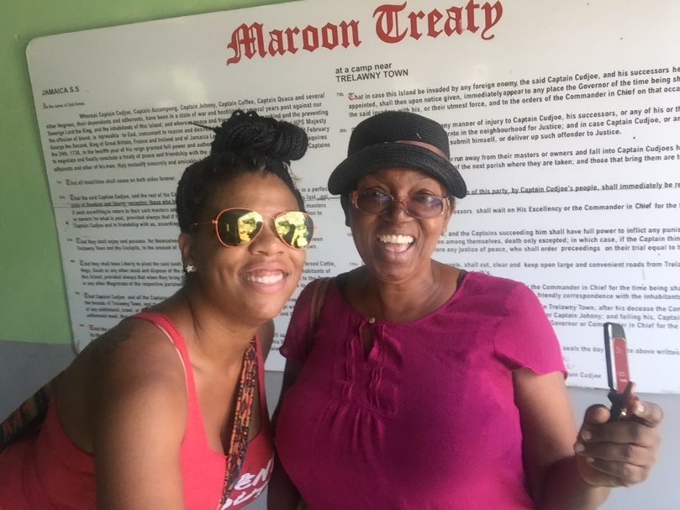
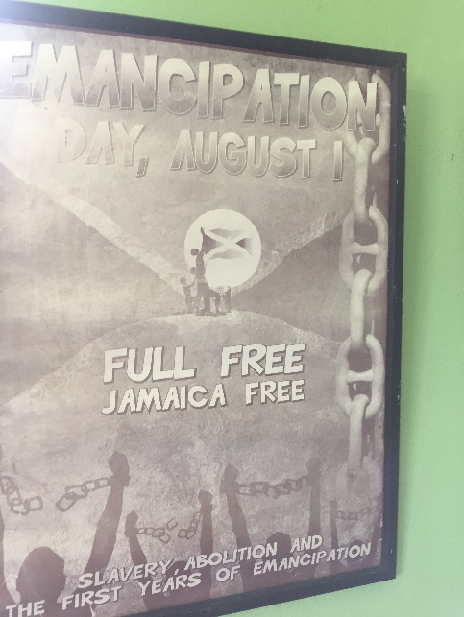
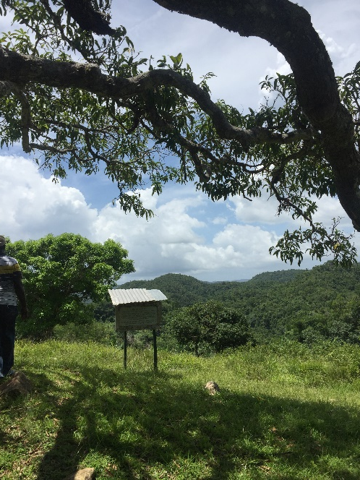
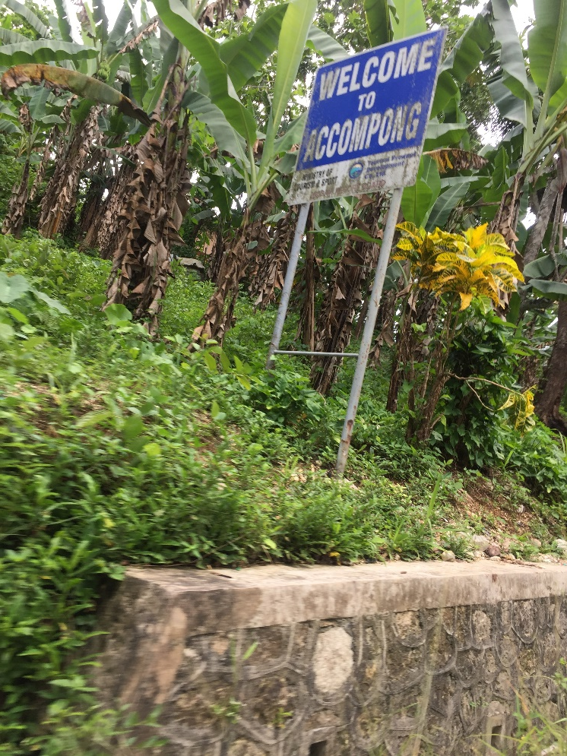
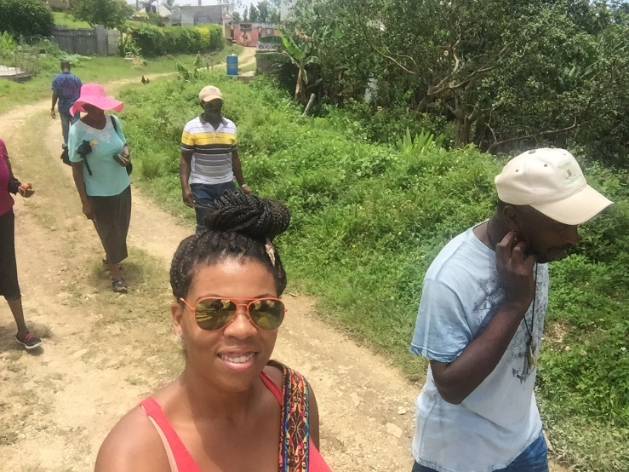
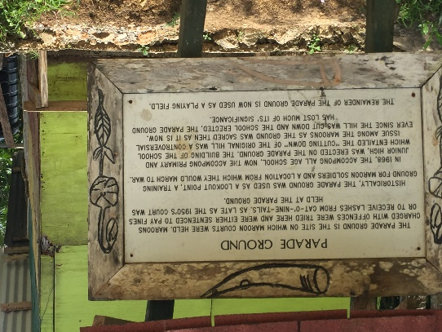
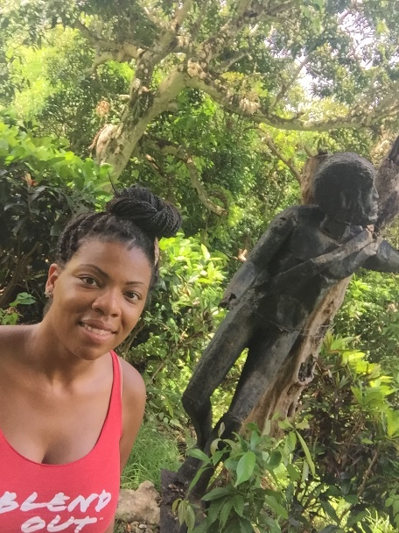
Accompong Tour & Museum Photos

