Slide 1
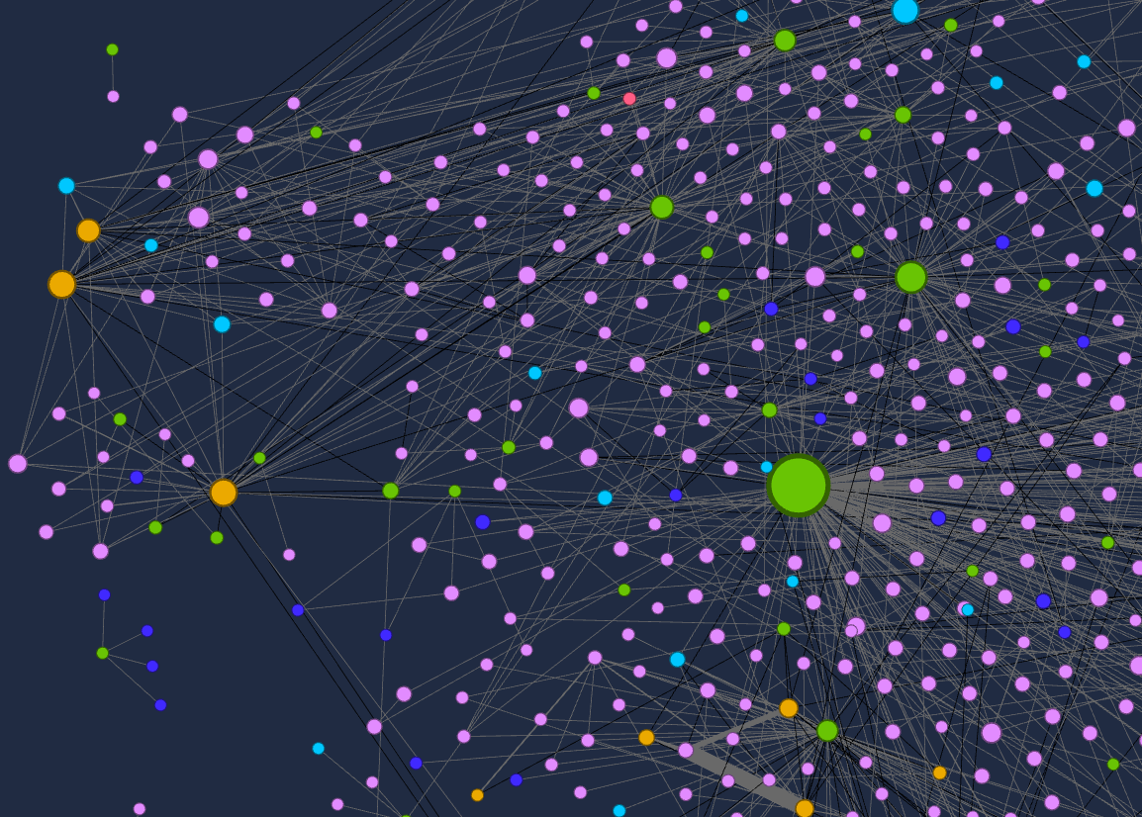
Network Analysis, Collections Data, and Provenance Jeffrey Smith Assistant Registrar for Collections Management smithje@si.edu CIMC Meeting, November 17, 2021

Slide 2
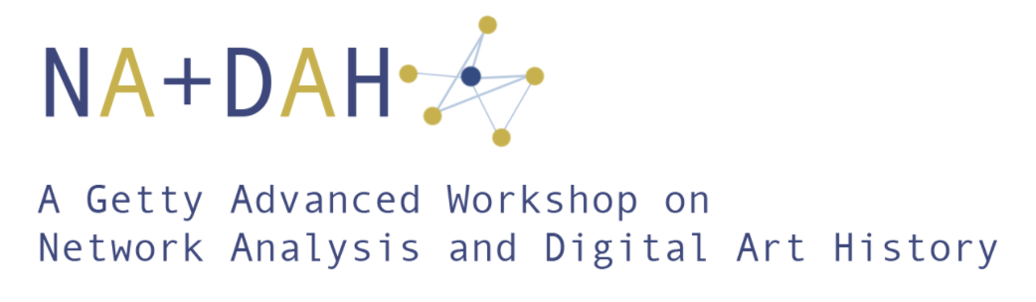
2019-2021
Ann Helmreich, Alison Langmead, Scott Weingart
Shack Hackney, John Ladd, et. al.
https://sites.haa.pitt.edu/na-dah/
asia.si.edu
Notes:
INITIATED IN 2018, STARTED 2019 /
6 OTHER RESEARCH TEAMS FROM US, CANADA, UK, EUROPE
NANCY MICKLEWRIGHT
SANA MIRZA
ZEYNEP SIMAVI
WEEK IN PITTSBURGH / MANY MEETINGS / CHECK-INS
MUST SAY: A SUPERB WORKSHOP – EXCELLENT ON ALL LEVEL
GREAT SUPPORT FROM VERY SMART, HELPFUL PEOPLE

Slide 3
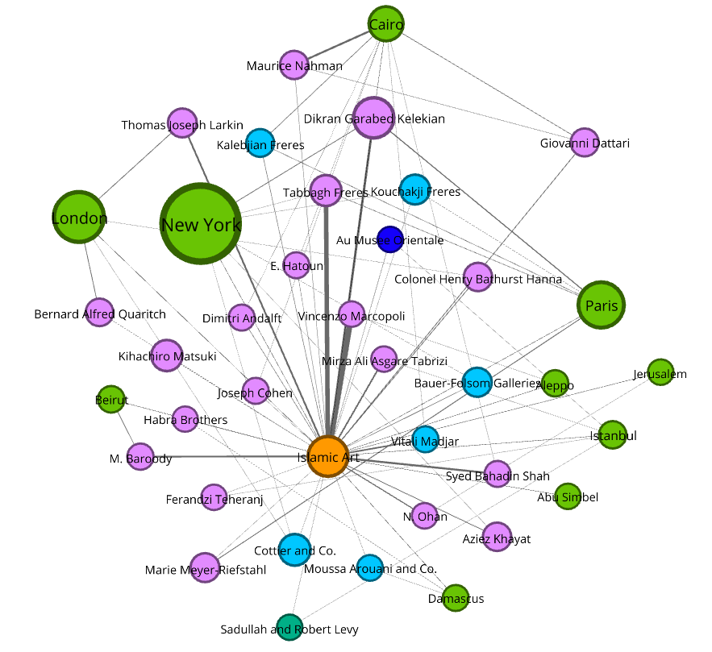
A Network: Nodes and Edges
Aw
Nodes
Constituents
Collection area
Locations
Edges
single or multiple associations between nodes
asia.si.edu

Slide 4
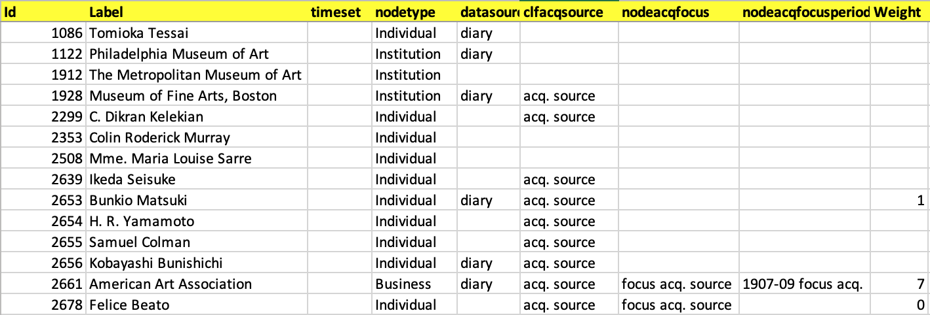
A Network: Node Data
Unimodal, Bimodal, Multimodal
Weighting, Attributes
asia.si.edu
Notes:
SEPARATE CSV FILES WHEN DONE

Slide 5
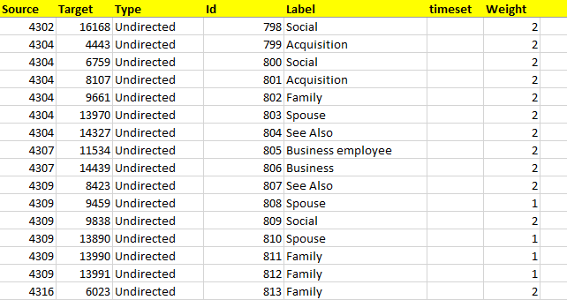
A Network: Edge Data
Source node & Target node
Directed Undirected
Weighting, Attributes
asia.si.edu

Slide 6
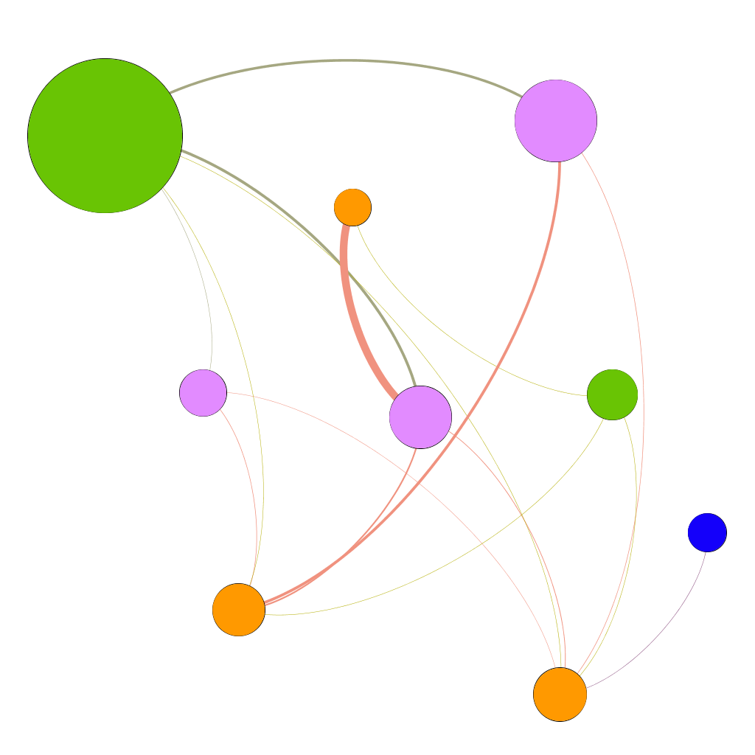
A Network: Inherent Relationships
By Visualization
Weighting
Attributes
Geographic coordinates
Date/Time
Dynamic graphs
asia.si.edu
Notes:
NA AS VISUALIZATION TOOL / QUANTITATIVE, QUALITATIVE ACHIEVED BY WEIGHTING / GEOSPATIAL AND TIME DATA ALLOWS DYNAMIC GRAPHS

Slide 7
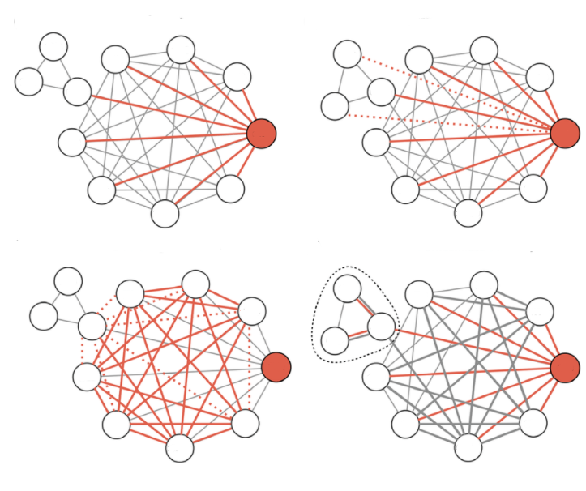
A Network: Inherent Relationships
By Mathematics
Degree
Betweenness
Centrality
Modularity
(modified from: researchgate.net)
asia.si.edu
Notes:
ALGORYTHIMS AT WORK – TO UNDERSTAND INFLUENCE OF CERTAIN NODES /
TYPES OF CENTRALITY:
CLOSENESS: A MEASURE OF THE CENTRALITY-DISTANCE TO OTHER NODES
BETWEENNESS: QUANTIFIES THE # OF TIMES A NODE ACTS AS A BRIDGE BETWEEN OTHER NODES ALONG THE SHORTEST PATH
EIGENVECTOR: A MEASURE OF INFLUENCE; A SCORING OF INFLUENCE, BASED ON CONNECTION TO OTHER INFLUENTIAL NODES
MODULARITY: A MEASURE OF THE DIVISION OF THE GRAPH INTO CLUSTERS, OR GROUPS.

Slide 8
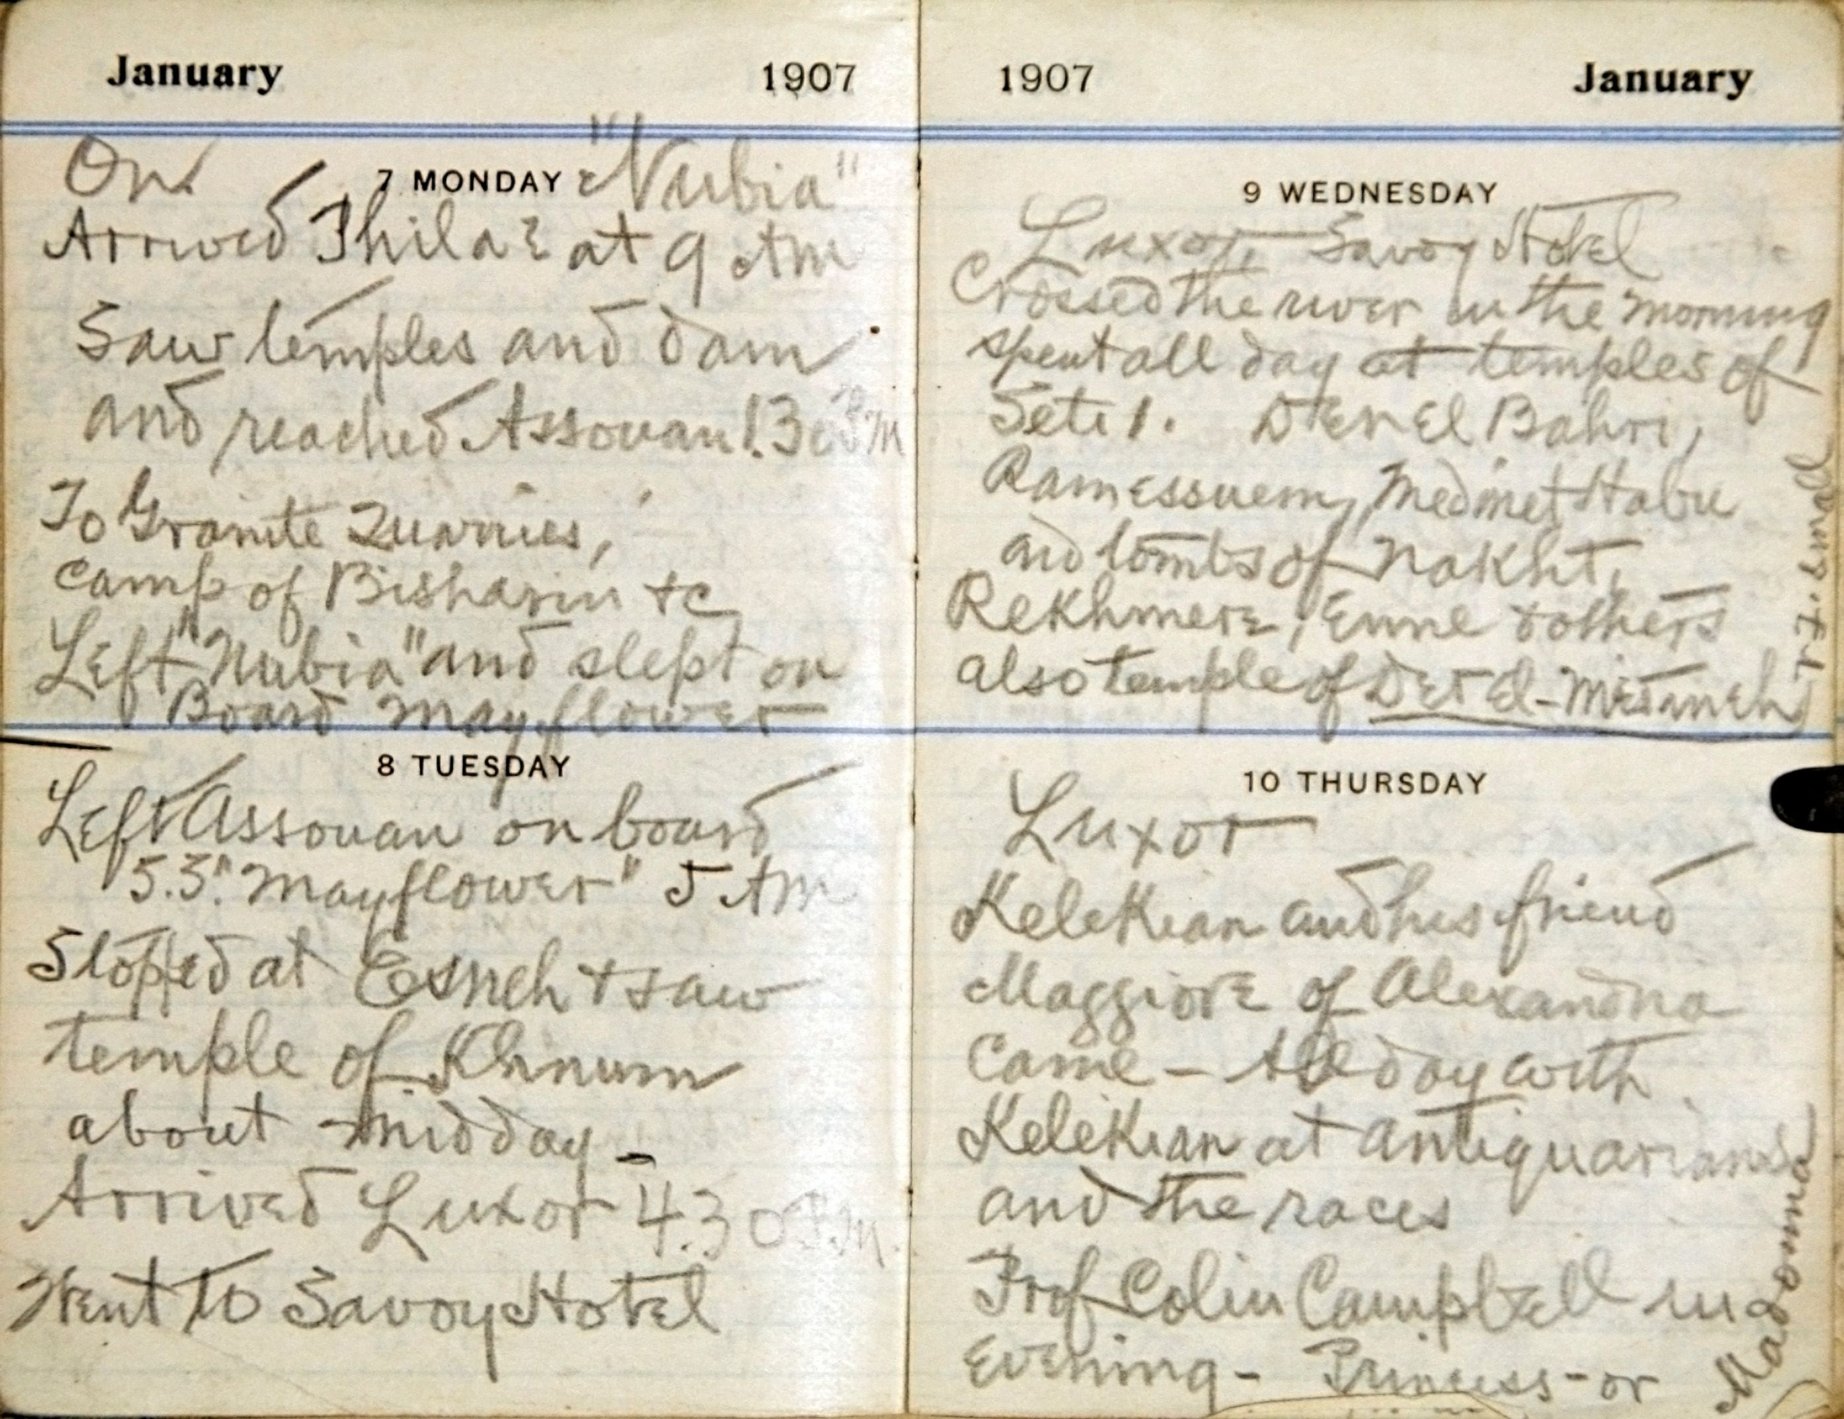
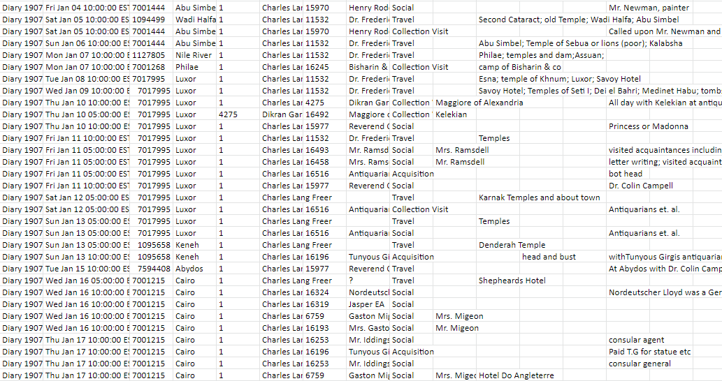
Research Goals and Data
Freer’s Photographs, Diaries, and Objects: Networking a National Collection
To understand Charles Lang Freer’s firsthand engagement with photography, Islamic, Near Eastern and South Asian art, through his acquisition sources, travel and social contacts.
Database records for Freer’s 1893 to 1919 acquisitions
Acquisition sources (322)
Associated people
2,237 transcribed entries from Freer’s 1907-1909 daily diaries
Acquisition
Business
Social
Travel
Additional research data
Reading
Internet research
asia.si.edu
Notes:
THOUGH FREER’S COLLECTING WELL-STUDIED, AREA OF ANCIENT NEAR EASTERN & ISLAMIC NOT AS MUCH. EGYPT YES – PRIOR RESEARCH HELPED
WE HAD TO BE AGNOSTIC TO OUTCOME /
MUCH OF THE WORK WAS VERIFYING IDENTIES, REFINING DATA VIA OPENREFINE, DATA ENTRY BACK INTO TMS
4 TRIPS TO EUROPE AND ASIA – WE FOCUSED ON ONE
DISPARITY BETWEEN TWO SETS OF DATA AT FIRST DIFFICULT /
CARE TAKEN TO BE VERY CLEAR ABOUT SETS WITHIN:
DIARY DATA ; CLF SOURCES ; CLF SOURCES DURING PERIOD ; CLF SOURCES FROM FOCUS AREA DURING PERIOD /
BUT INCLUSION OF OVERALL ACQUISITIONS DATA FRAMED THE AREAS OF RESEARCH FOCUS /
1907-09 A WINDOW DURING PIVOTAL YEAR OF 1906 – GIFT TO SMITHSONIAN /

Slide 9
Goals for Collections Management
Learn network analysis
Learn to use Gephi, QGIS
Learn to use OpenRefine to clean and reconcile large sets of data
Integrate research and TMS data
Experience collaborative digital humanities research
Understand network data within a collections management database
Export network data via SQL and Excel
Understand how network analysis could support provenance research
Explore the potential of network graph as search interface for provenance
asia.si.edu
Notes:
LEARN NEW THINGS / APPLICATION TO PROVENANCE / SHORT NMAA PROVENANCE HISTORY / OVER 23,000 RECORDS W SOME PROVENANCE

Slide 10
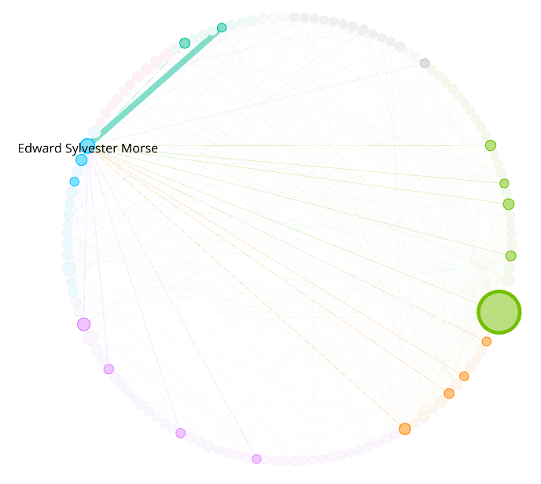
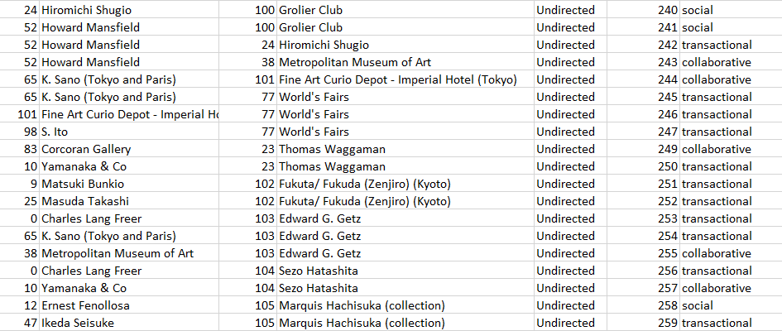
Recording and Managing Network data in TMS
Sonia Coman-Ernstoff
Network analysis of Charles Lang Freer’s
acquisition sources for
Japanese ceramics
(Graph created by Jeffrey Smith)
asia.si.edu
Notes:
PRIOR EXAMPLE OF SONIA’S RESEARCH DATA

Slide 11
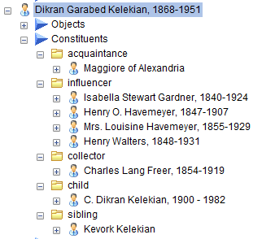
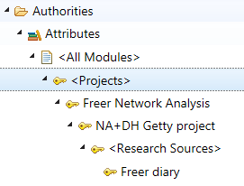
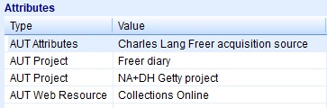
Recording and Managing Network data in TMS
How to allow for growth of network data in TMS
How to selectively mark data related to a research project
Constituent Associations
Thesaurus terms for project management
asia.si.edu

Slide 12
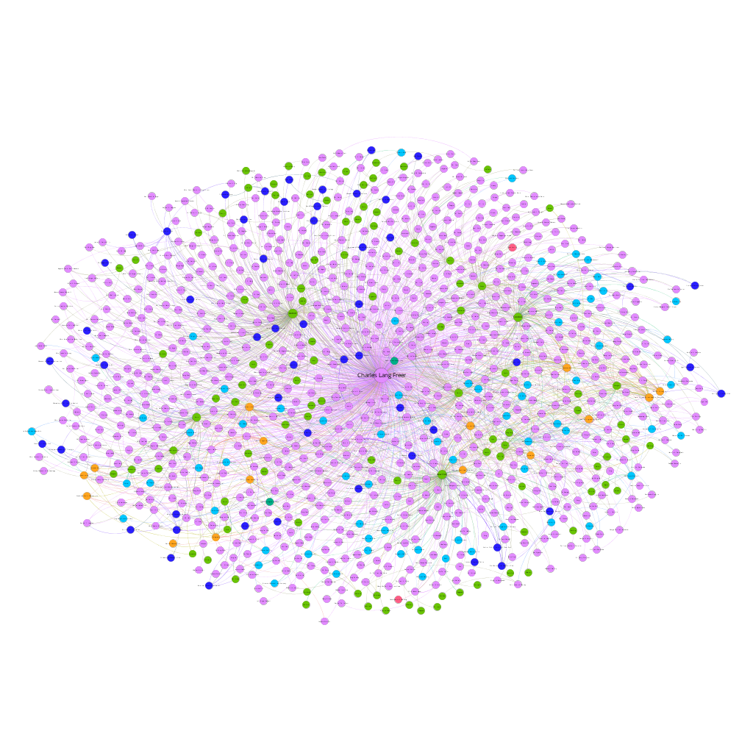
Freer’s Ego Network
Individual
Business
Institution
Couple
Collection area
Location
asia.si.edu

Slide 13
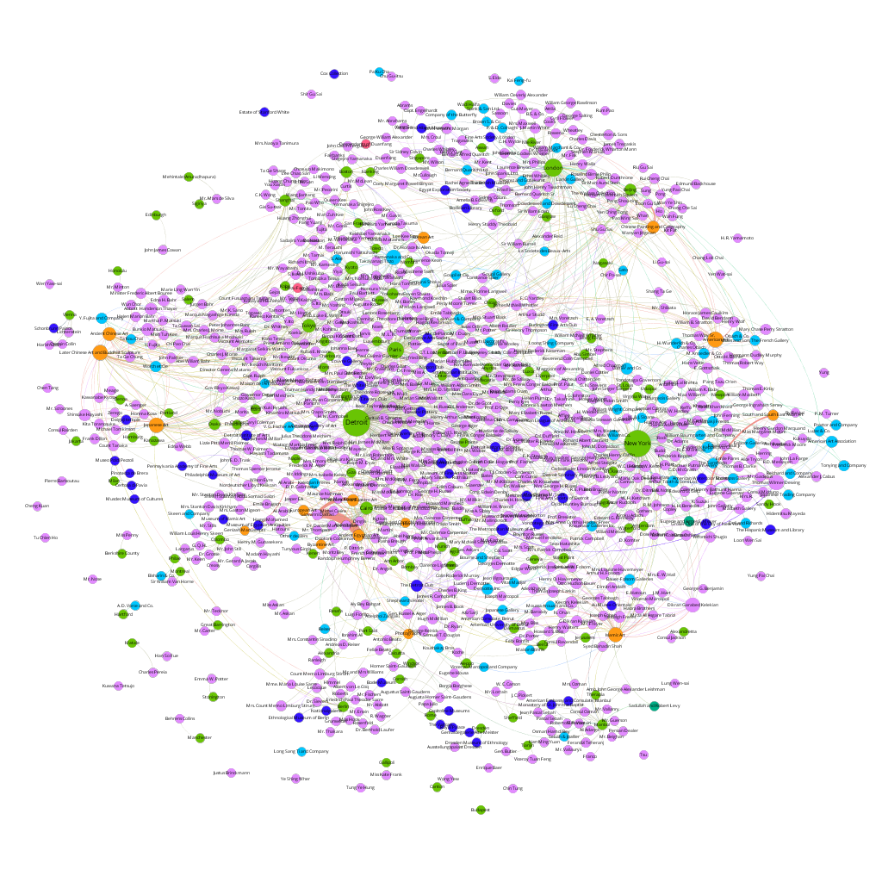
Freer’s Network without Freer
Individual
Business
Institution
Couple
Collection area
Location
asia.si.edu

Slide 14
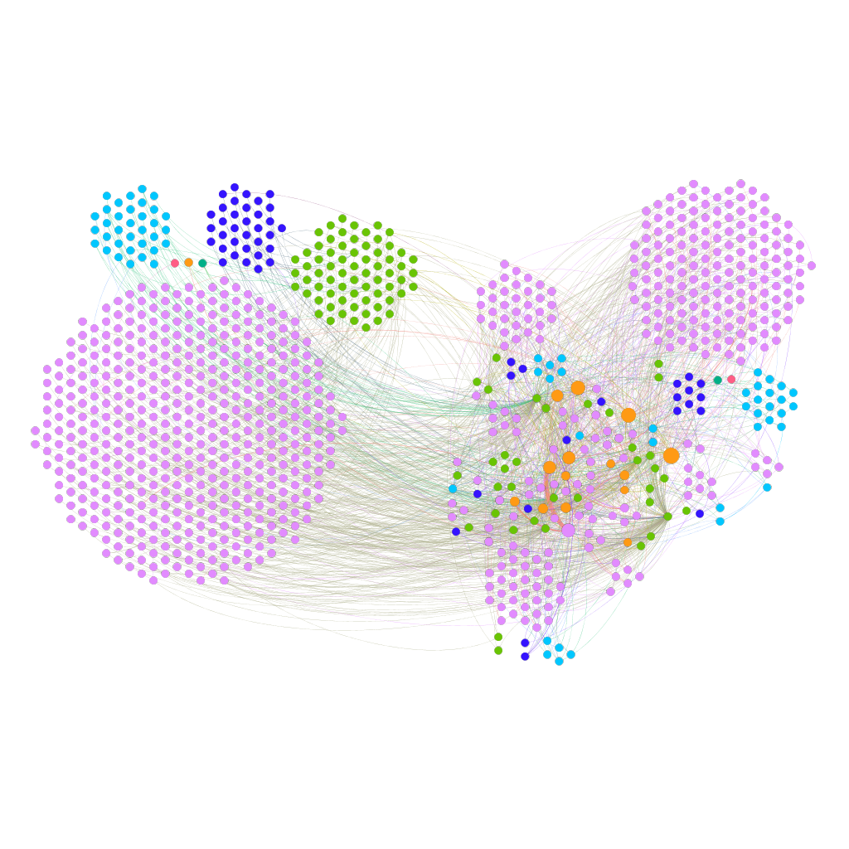
Freer’s Network without Freer
Individual
Business
Institution
Couple
Collection area
Location
asia.si.edu

Slide 15
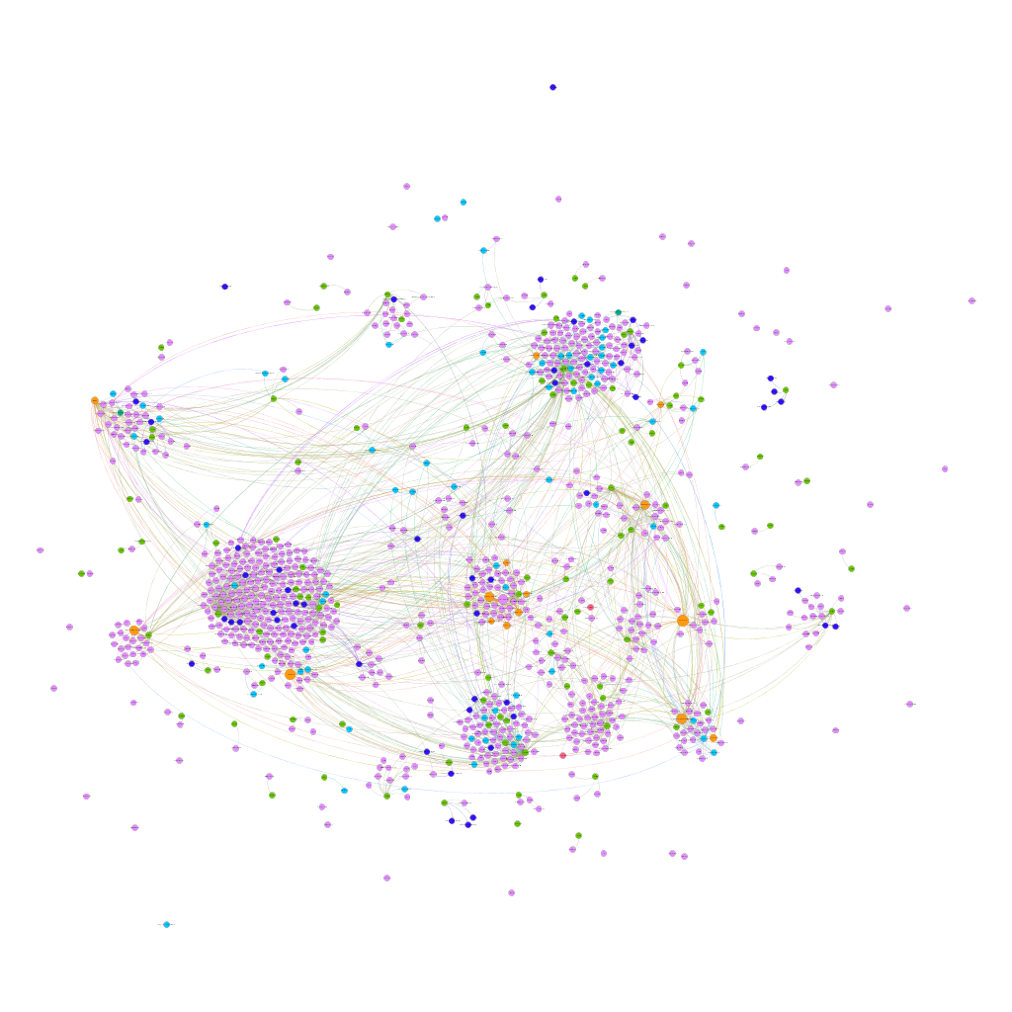
Freer’s Network without Freer
Individual
Business
Institution
Couple
Collection area
Location
asia.si.edu

Slide 16
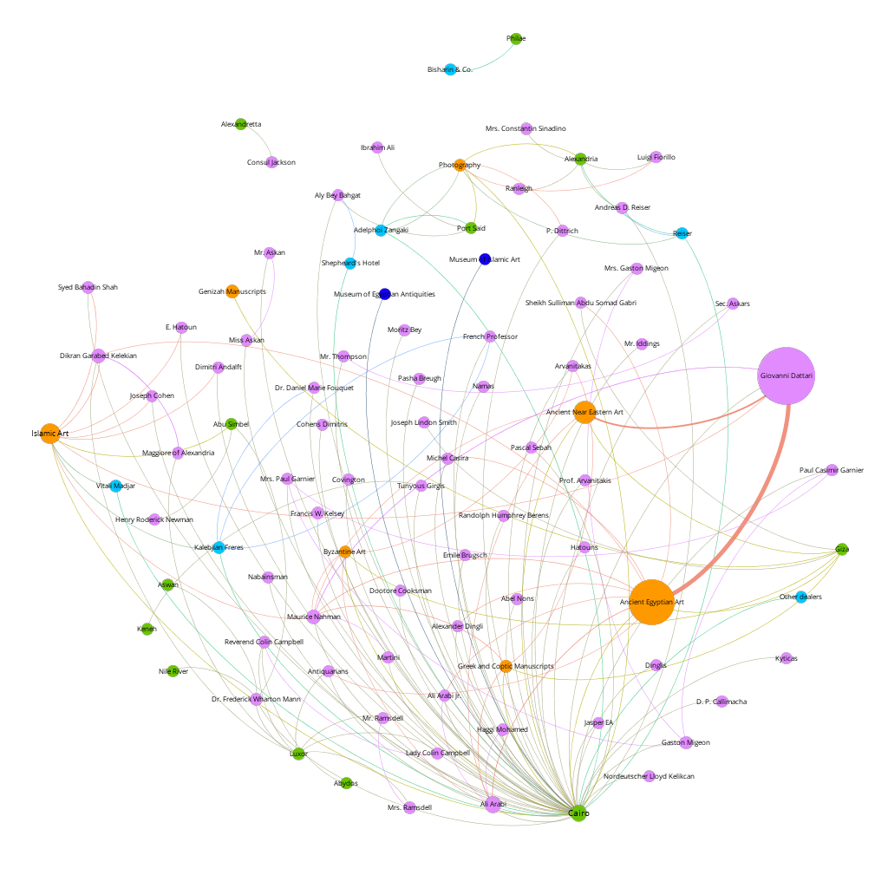
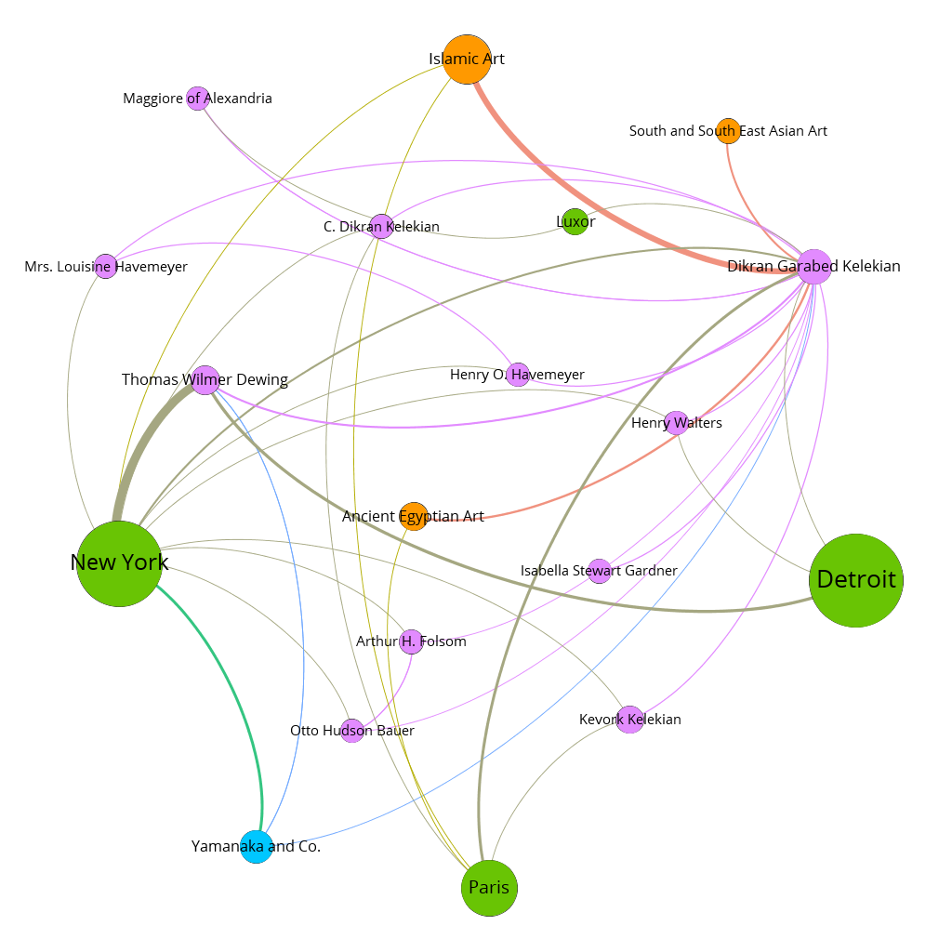
Freer’s Network without Freer
asia.si.edu
Dikran Garabed Kelekian
Egypt

Slide 17
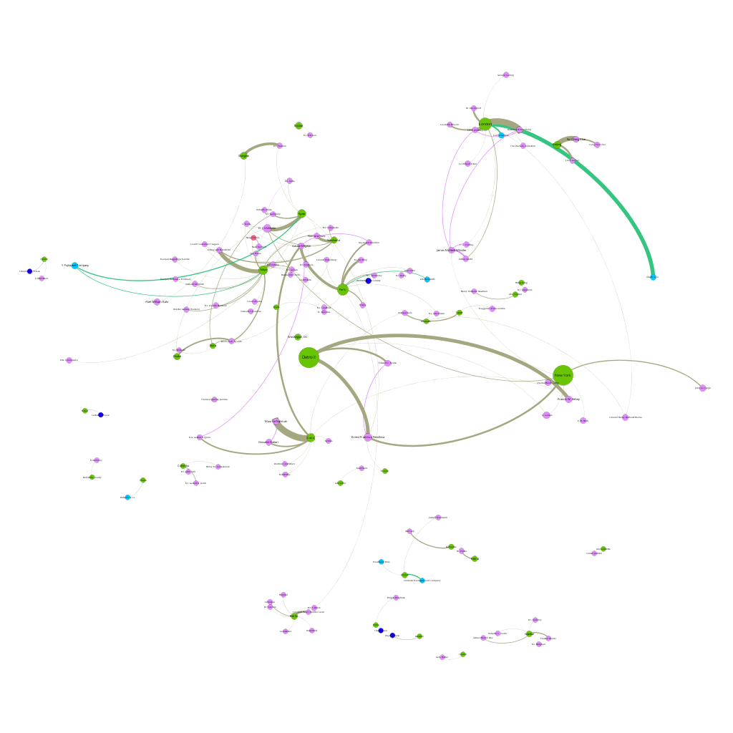
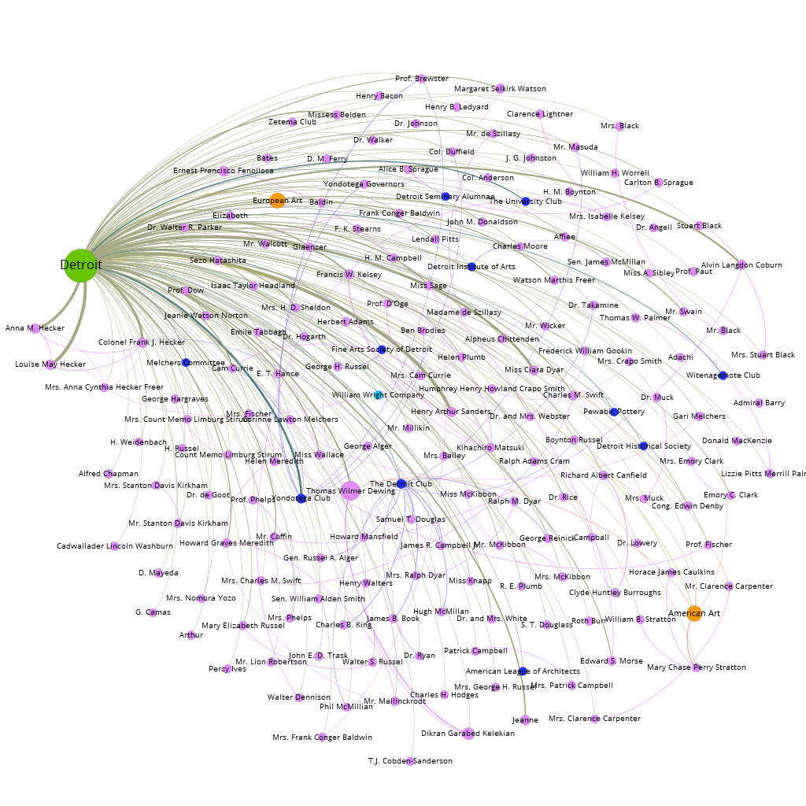
Freer’s Network without Freer
asia.si.edu
Detroit
Collection Visits

Slide 18
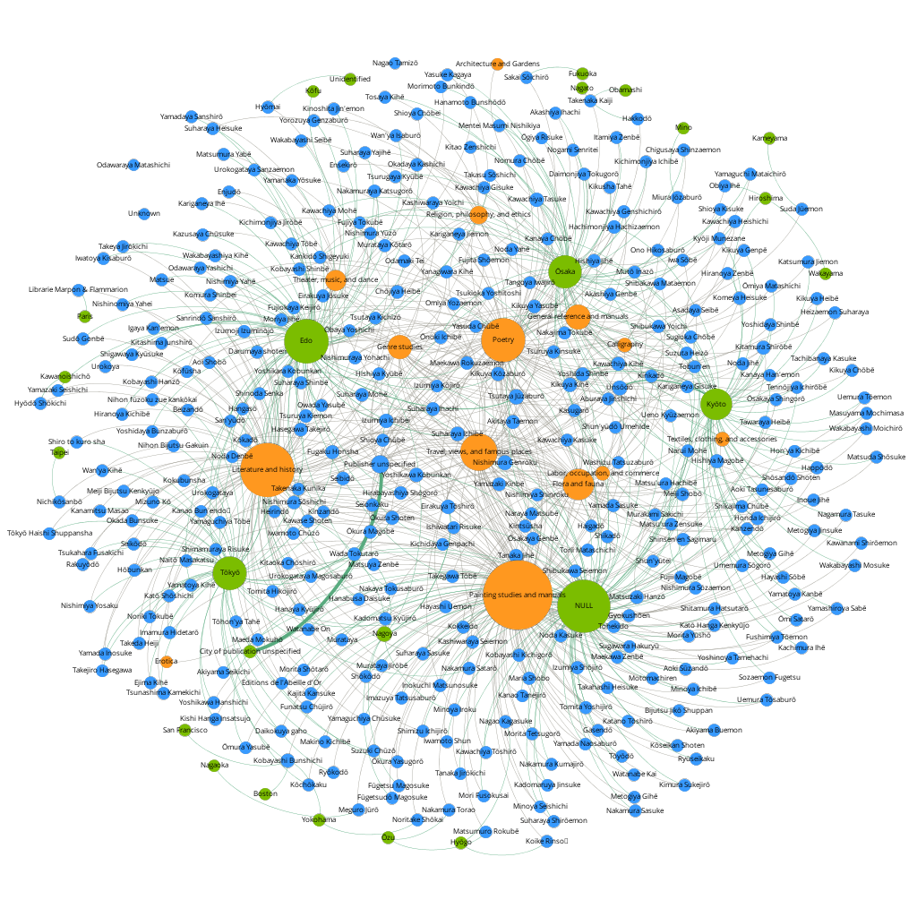

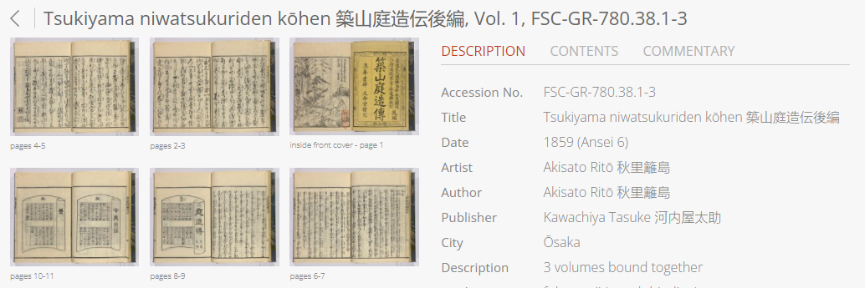
Edo Period Book Publishers, Genres, and Locations
Col
Pulverer Collection of Japanese Books
Pulverer.si.edu
asia.si.edu

Slide 19
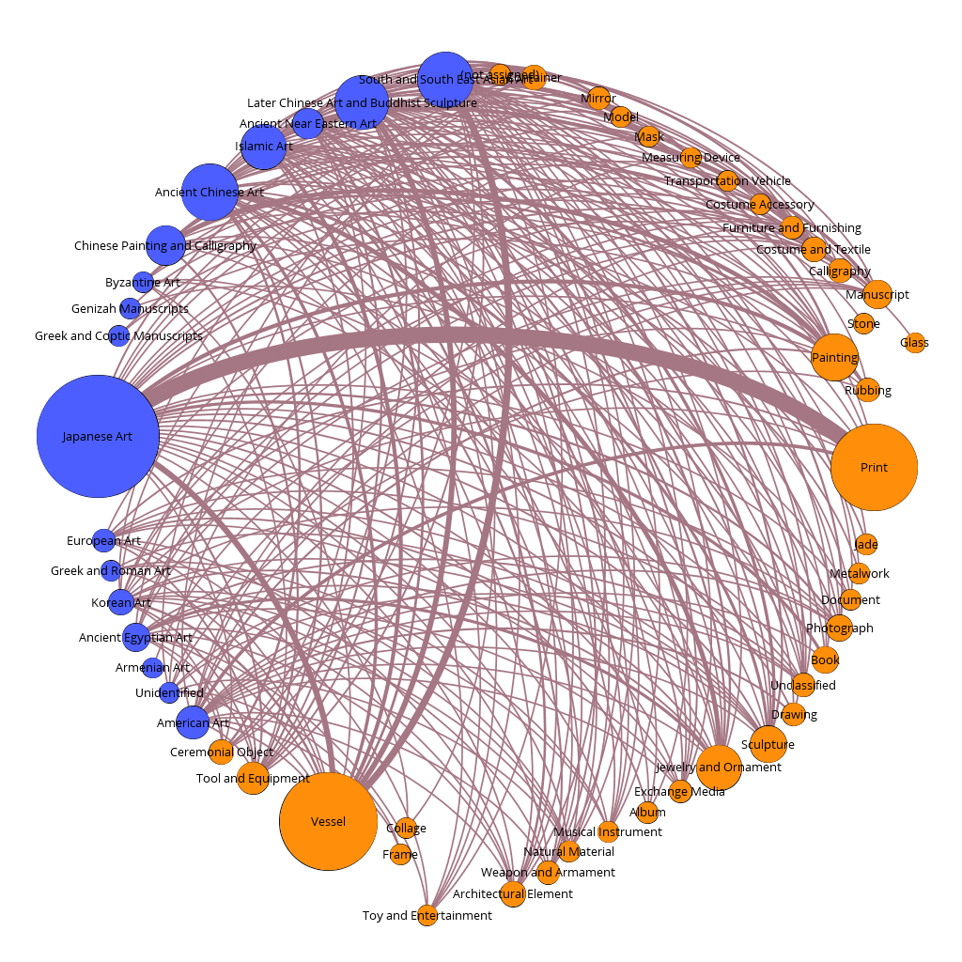
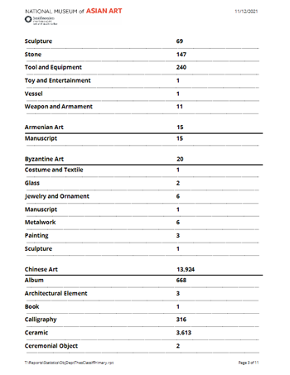
Visualizing Collection Statistics
Col
Departments and Classifications
asia.si.edu

Slide 20
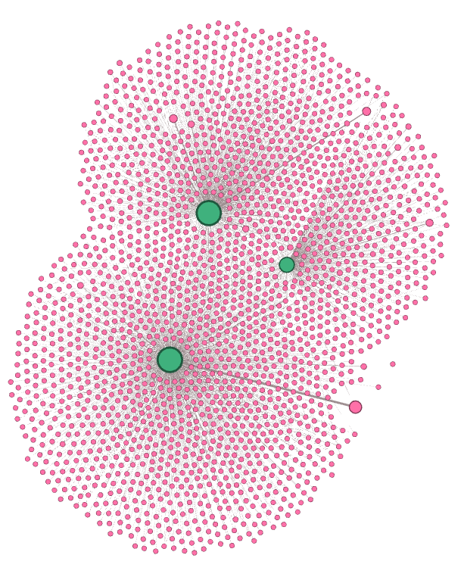
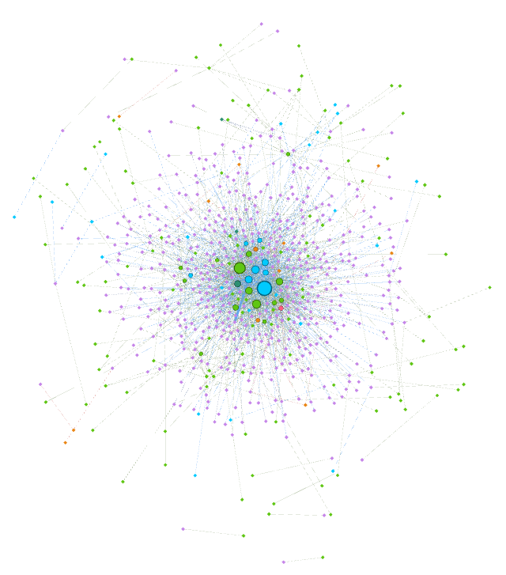
NMAA Previous Owners
Col
WWII Research-related Previous Owners
Freer, FSC, Sackler Collections and Previous Owners
asia.si.edu
Notes:
ATTENTION TO PROVENANCE-RELATED NETWORKS
WWI-RESEARCH RELATED
OVERALL EX-COLLECTION CONSTITUENTS IN TMS FOR ALL OBJECTS

Slide 21
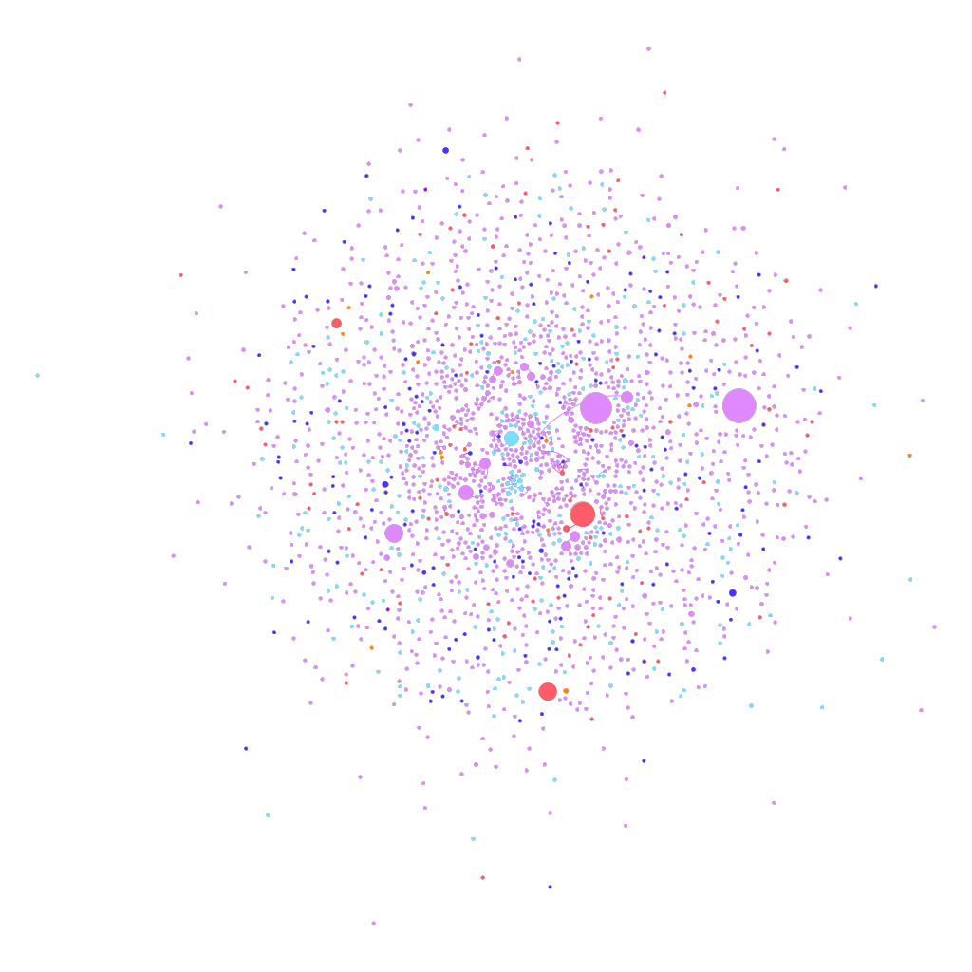
NMAA Previous Owners
Col
asia.si.edu
Notes:
OVERALL EX-COLLECTION CONSTITUENTS IN TMS FOR ALL OBJECTS /
CONNECTED ONLY TO EACH OTHER

Slide 22
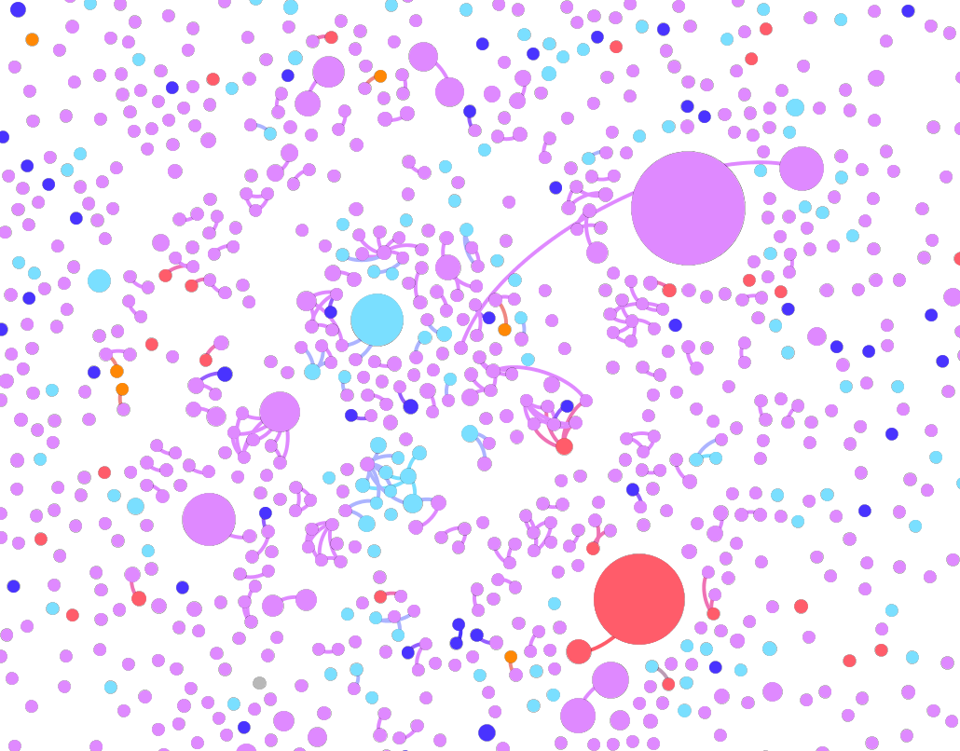
Col
asia.si.edu

Slide 23
NMAA Provenance Research: what we record
Col
Provenance statement
Ex-Collection Constituents linked to Objects
Excavated at Liangshan in Shouzhang xian, Shandong province, China, in mid-19th century [1]
Zhong Yangtian (Zhong Yanpei) collection, Jining, Shandong province [2]
Li Zongdai (active 1849-1896) collection [3]
Pulun (1869-1925/27) collection [4]
Huang Jun (1880-1952) collection [5]
Possibly Ding collection, Weixian, Shandong province [6]
To 1915
Marcel Bing (1875-1920), Paris, France [7]
1915 to 1959
Eugene Meyer (1875-1959) and Agnes E. Meyer (1887-1970), Washington, DC and Mt. Kisco, NY, purchased from Marcel Bing through C. T. Loo, Lai Yuan & Co., New York in December 1915 [8]
1959 to 1961
Agnes E. Meyer inherited upon the death of her husband, Eugene Meyer on July 17, 1959 [9]
From 1961
Freer Gallery of Art, gift of Eugene and Agnes E. Meyer, 1961 [10]
Custodian: Lai-Yuan
Custodian: C.T. Loo
Previous custodian or owner: Zhong Yangtian
Previous custodian or owner: Li Zongdai
Previous custodian or owner: Pulun
Previous custodian or owner: Huang Jun
Previous custodian or owner: Ding collection
Previous custodian or owner: Marcel Bing
Previous custodian or owner: Eugene Meyer, Agnes E. Meyer
asia.si.edu
Notes:
REFERENCE 3 LAYERS OF PROVENANCE: LAYER 2
WORKS WELL FOR US – IMPROVES GOOGLE SEARCH
CONSTITUENT RECORDS PROVIDE PLATFORM FOR BIO DATA, ONLINE RECORDS
ASSOCIATIONS CREATED MOSTLY FAMILY-RELATED

Slide 24
NMAA Provenance Research: we don’t record associations
Col
Excavated at Liangshan in Shouzhang xian, Shandong province, China, in mid-19th century [1]
Zhong Yangtian (Zhong Yanpei) collection, Jining, Shandong province [2]
Li Zongdai (active 1849-1896) collection [3]
Pulun (1869-1925/27) collection [4]
Huang Jun (1880-1952) collection [5]
Possibly Ding collection, Weixian, Shandong province [6]
To 1915
Marcel Bing (1875-1920), Paris, France [7]
1915 to 1959
Eugene Meyer (1875-1959) and Agnes E. Meyer (1887-1970), Washington, DC and Mt. Kisco, NY, purchased from Marcel Bing through C. T. Loo, Lai Yuan & Co., New York in December 1915 [8]
1959 to 1961
Agnes E. Meyer inherited upon the death of her husband, Eugene Meyer on July 17, 1959 [9]
From 1961
Freer Gallery of Art, gift of Eugene and Agnes E. Meyer, 1961 [10]
Marcel Bing
Eugene Meyer
Marcel Bing
Agnes E. Meyer
Marcel Bing
C. T. Loo
Eugene Meyer
Agnes E. Meyer
Eugene Meyer
Freer Gallery of Art
Agnes E. Meyer
Freer Gallery of Art
asia.si.edu
Notes:
EXAMPLE OF FULL ASSOCIATIONS

Slide 25
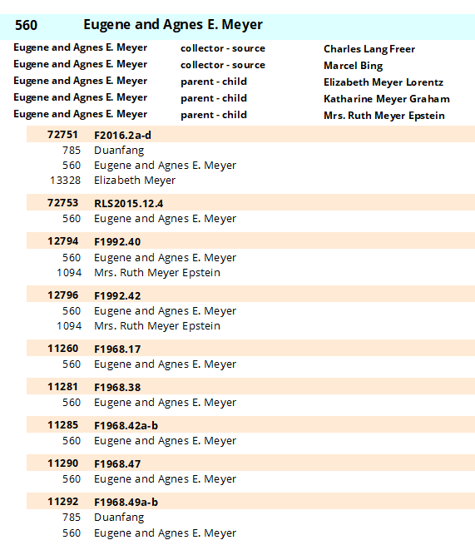
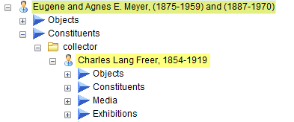

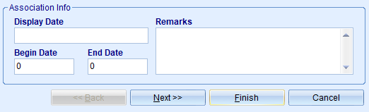
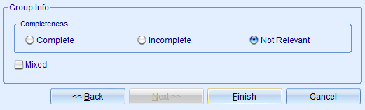
How feasible is it to assess & create these associations?
2,102 constituents for 66,351 shared objects
asia.si.edu
Notes:
MUST COMPILE A DISTINCT LIST OF A TRANSACTION-BASED LINKS BTWN CONSTITUENTS
OPTION: SINGLE LINK /
OPTION: AT MOST, SINGLE LINK WITH COUNT OF CONNECTIONS /
LACK OF EVENT DATA /
TESTED FEASIBILITY OF EVENT RECORDS LONG AGO /
HAVING A VISIBLE TRANSACTION-BASED NETWORK WOULD BE HELPFUL /
WHAT DO PROVENANCE RESEARCHERS THINK? WHAT DO THEY NEED?

Slide 26
Provenance data: text and structured data
Human-readable and machine-readable
Linked Open Data
Provenance transactions expressed as linked data with the CIDOC-CRM
Carnegie Museum of Art - Art Tracks
https://cmoa.org/art/art-tracks-digital-provenance-project/
Elysa tool
Linked Art
https://linked.art/
Getty Provenance Index Remodel https://www.getty.edu/research/tools/provenance/provenance_remodel/index.html
TMS Events Module and Provenance
Rupert Shepherd, National Gallery of Art, London
Gallery Systems, New York
asia.si.edu
Notes:
THE DILEMMA OF MODELING PROVENANCE FOR DATA /
LACK OF EVENT RECORDS /
WORK ON CIDOC-CRM & LINKED DATA /
3 LAYERS OF PROVENANCE /
AGAIN, WHAT DO PROVENANCE RESEARCHERS NEED?

Slide 27
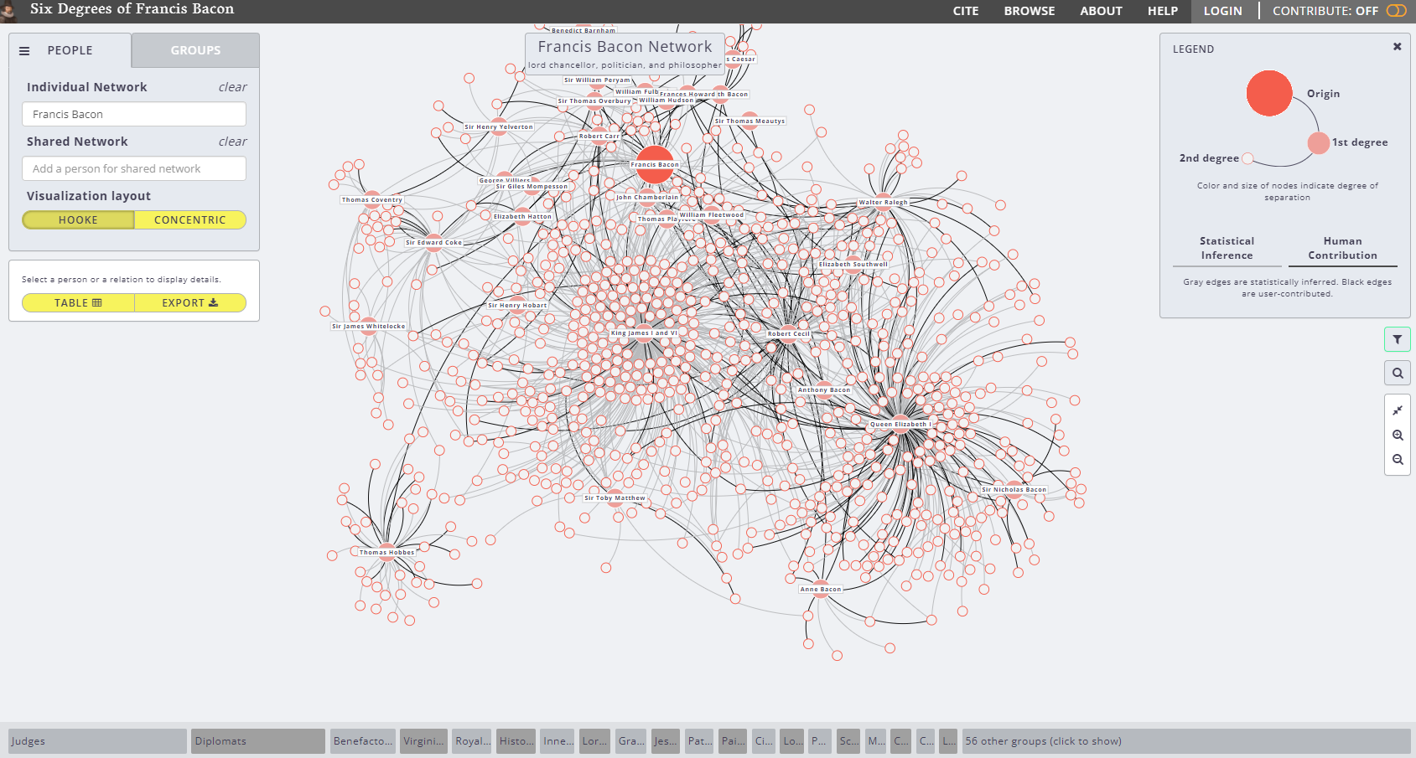
The Network Graph as Search Interface
Six Degrees of Francis Bacon http://www.sixdegreesoffrancisbacon.com/
asia.si.edu
Notes:
GOOD EXAMPLES OF WHAT NETWORK DATA CAN PROVIDE / HERE ARE SOME EXAMPLES:
FOR VISUALIZATION
FOR SEARCH
ANOTHER WAY OF THINKING

Slide 28
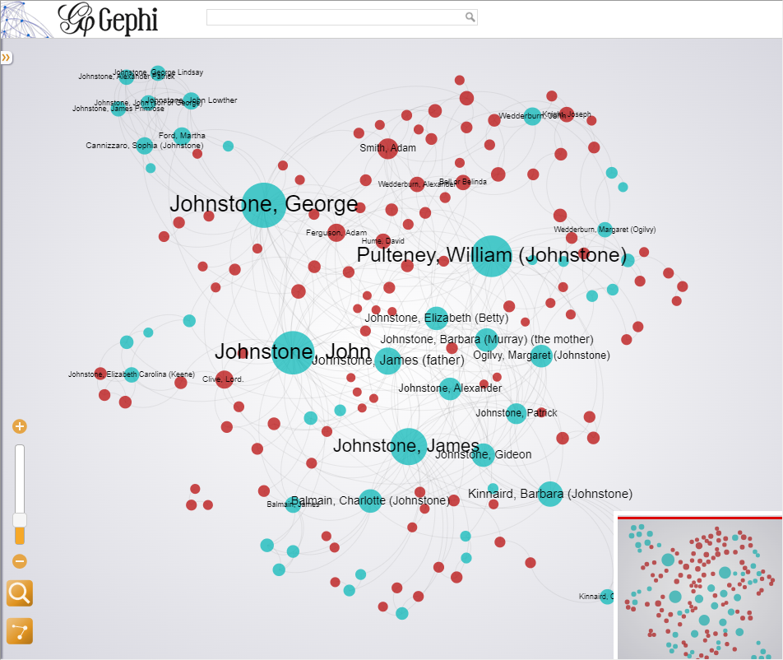
The Network Graph as Search Interface
Visualizing Historical Networks: The Inner Life of Empires https://histecon.fas.harvard.edu/innerlife/connections-basic.html
asia.si.edu
Notes:
HARVARD’S VISUALIZING HISTORICAL NETWORKS / SIMPLE SEARCH INTERFACE

Slide 29
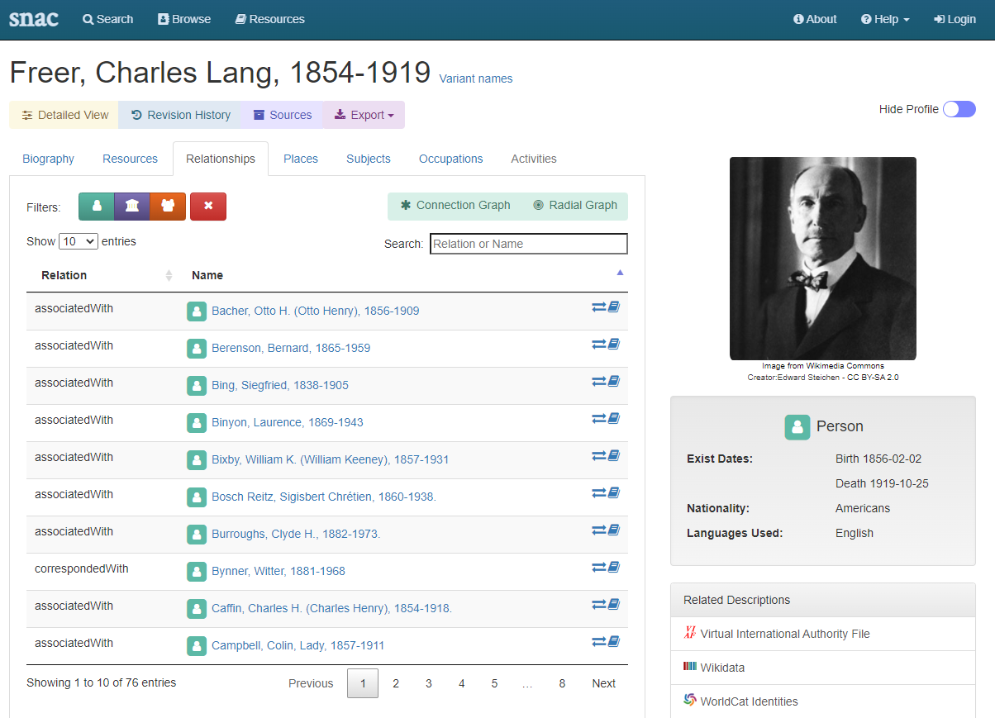
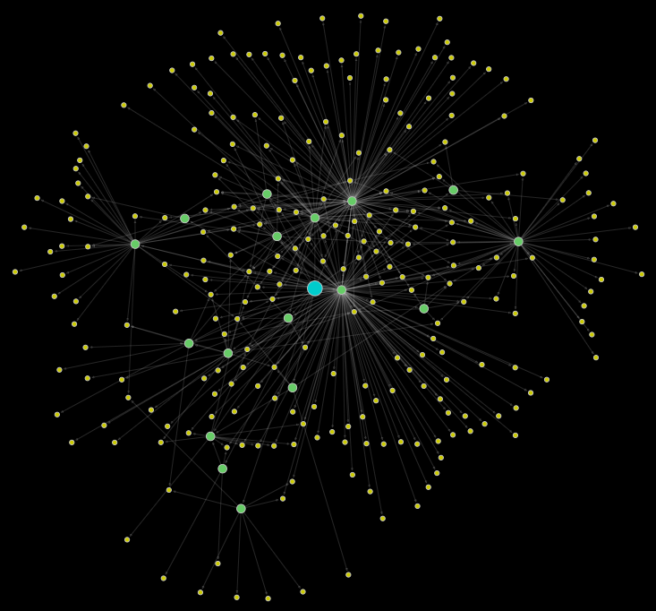
The Network Graph as Search Interface
Social Networks and Archival Context (SNAC) https://histecon.fas.harvard.edu/innerlife/connections-basic.html
asia.si.edu
Notes:
SNAC INITIATIVE AMONG ARCHIVES /
LIMITED BY PARTICIPATION? /
PROMISING

Slide 30
The Network Graph as Search Interface for Provenance
It’s visual
Behind each node is an ID – linked to all other related information and assets
Behind each edge – other potential data
It’s scalable
single link
single link with weight (# transactions)
links to multiple events
It can be expressed as Linked Data
Potential to integrate other museum data - Museums share the same people!
Follow research questions, researcher needs, desired outcomes, intended audiences
What are the questions to ask?
asia.si.edu
Notes:
WHY PURSUE A NETWORK GRAPH FOR VISUALIZING PROVENANCE?

Slide 31
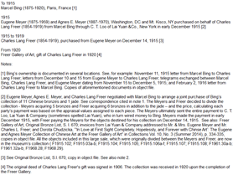
The Network Graph as Search Interface for Provenance
objects:
22567
22568
22569
22567
Object number
Image
Caption data
Provenance
22567
Provenance
560
transaction(s)
Collection
objects:
22567
22568
23402
23403
720
asia.si.edu
Notes:
AT MINIMUM, NETWORK GRAPH PROVIDES ACCESS TO DATA AT MANY LEVELS

Slide 32
Thank you
asia.si.edu

